Slide 1



CONSERVE. PROTECT. LEAD.
TFSWEB.TAMU.EDU
ROOTS TO RIVERS
CONSERVATION EDUCATION AND PARTNERSHIPS WITH TEXAS A&M FOREST SERVICE
Jaden Kelly
Sam Hill
Program Specialist II
Woodland Ecologist
Conservation Education
Water Resources

Slide 2

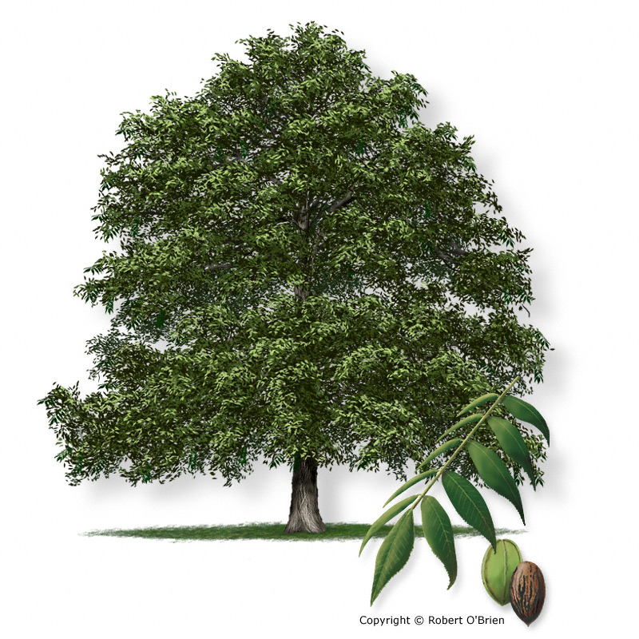
50% of freshwater resources in Texas originate on forestlands.
Texas Forest/Water services are valued at $13.2 billion annually.
TFSWEB.TAMU.EDU

Slide 3
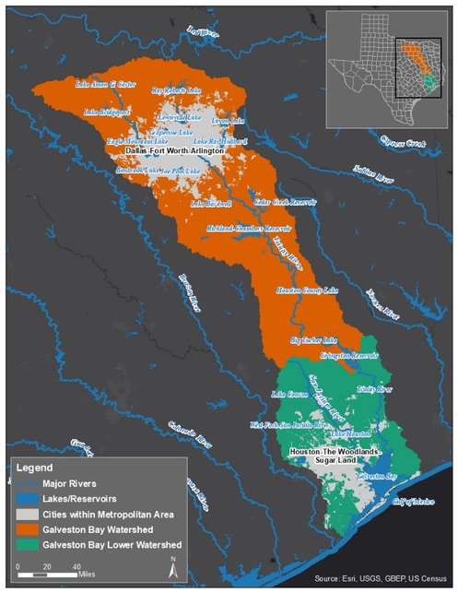
FOREST BENEFIT TO GALVESTON BAY
Healthy trees and forests are critically important to protecting water resources in the Galveston Bay watershed
    Absorb rainfall
    Slow and filter stormwater runoff
    Mitigate erosion
    Reduce flooding
    Refill groundwater aquifers
    Maintain watershed stability and resilience
TFSWEB.TAMU.EDU

Slide 4
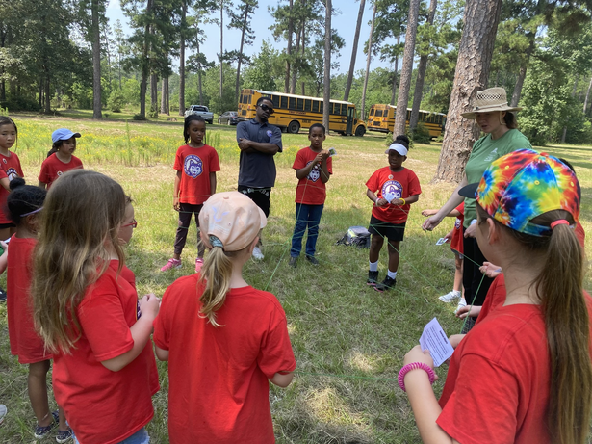
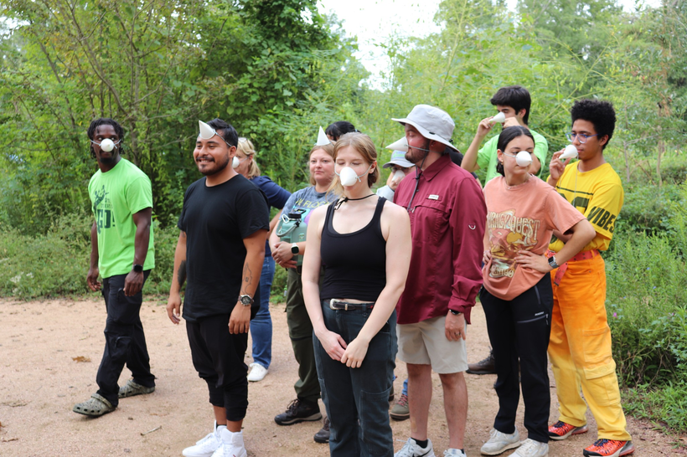



PROJECT LEARNING TREE
Teaching Students
How to Think, Not What to Think
  Hands-on, TEKS‑aligned environmental education uses forests and nature as a lens on the world.
  Supports PreK–12 programs, interdisciplinary learning, and builds stewardship.
  Easy to integrate into camps, classrooms, and community programs.
TFSWEB.TAMU.EDU

Slide 5
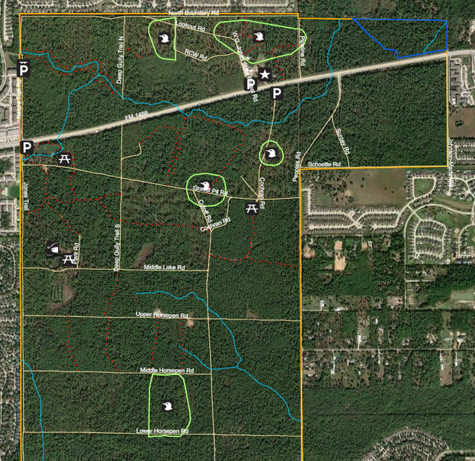
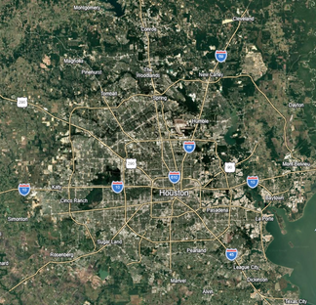
W.G. JONES STATE FOREST
Working urban forest 40 miles north of Houston
  1,730 acres
  100,000 + visitors annually
  17+ miles of trails
  Open dawn to dusk, No entrance fee
  2 ponds, 3 parking areas, classroom
  Pollinator Gardens & Nursery
  No restrooms or trashcans on forest
  Commercial forestry operations
  Special Interest Education Projects
  Recreational use
TFSWEB.TAMU.EDU

Slide 6
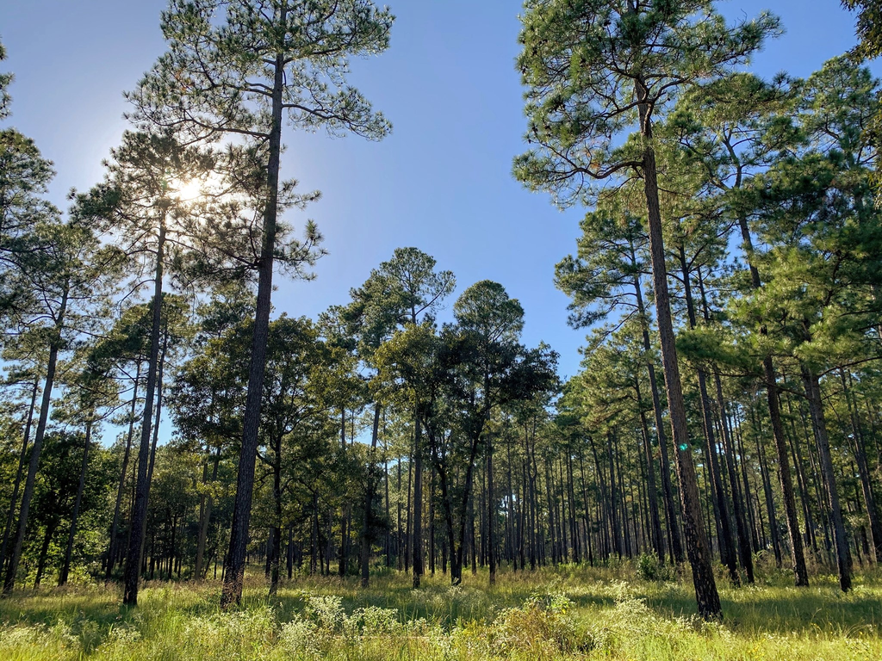
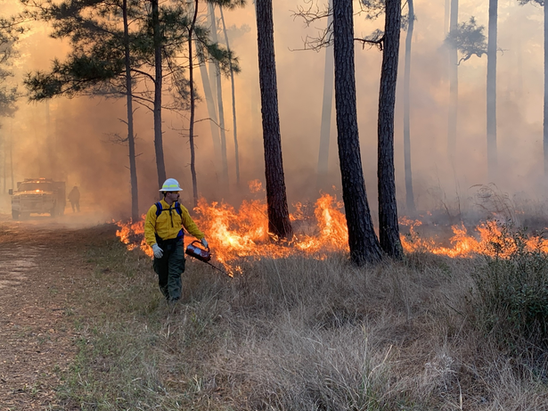

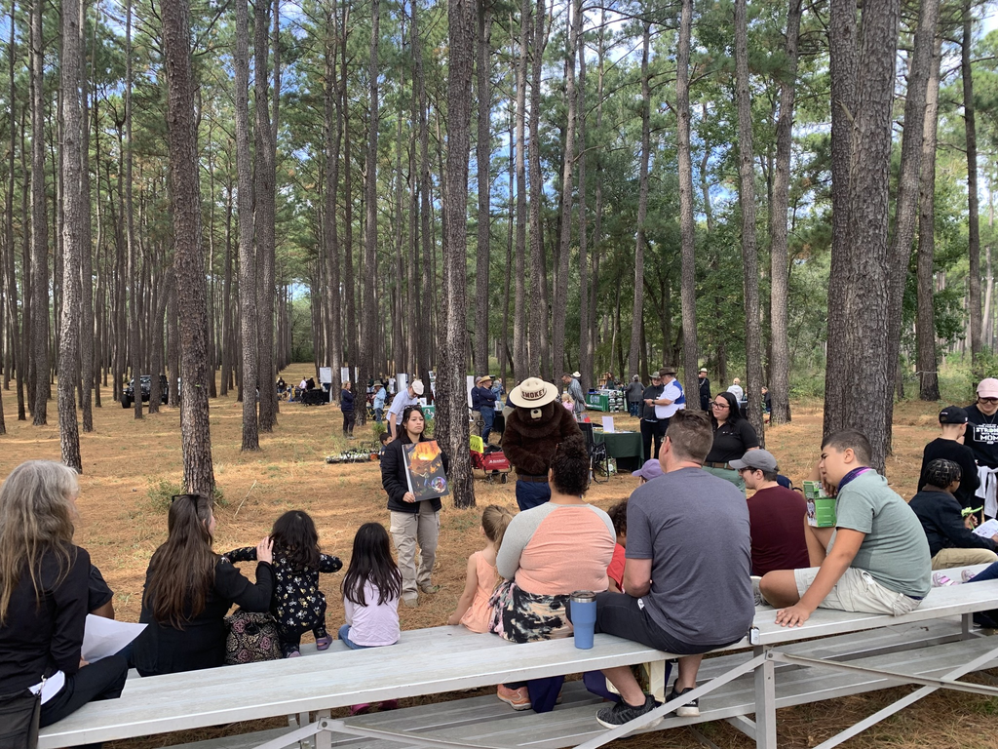
W.G. JONES STATE FOREST
TFSWEB.TAMU.EDU

Slide 7
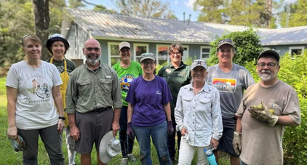
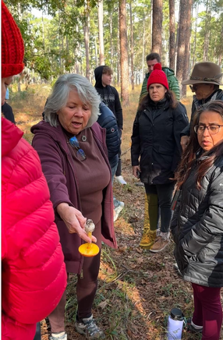
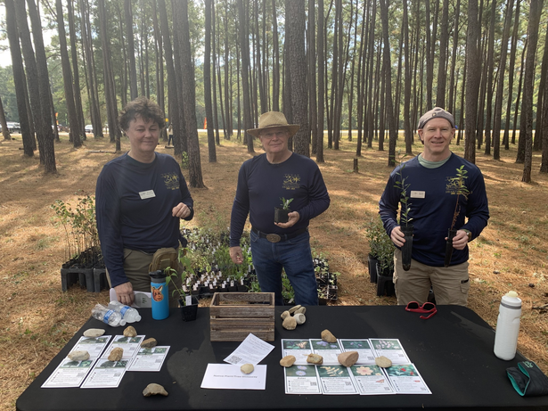
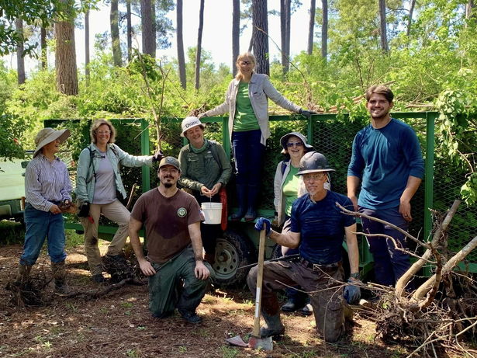
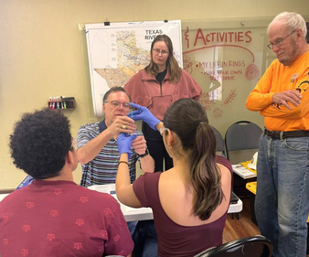
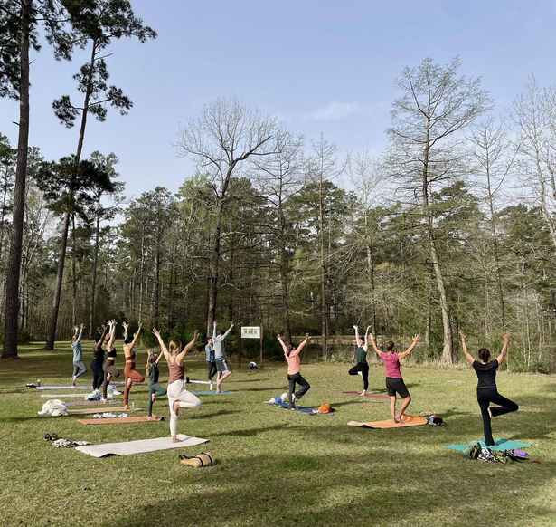
CURRENT PROJECTS AT JONES FOREST
  Educational Programming & Training
  Invasive Species Removal
  Field Trips & Festivals
  Pollinator Gardens & Nursery
  Trail Maintenance
  Research & Citizen Science
  Litter Audits
TFSWEB.TAMU.EDU

Slide 8
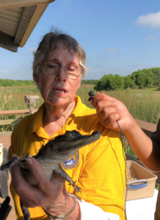
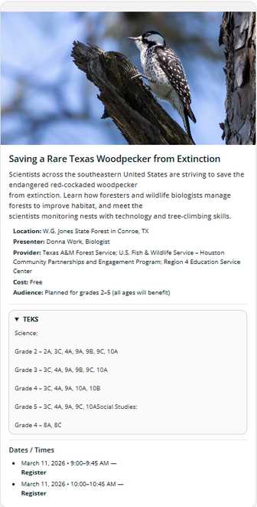
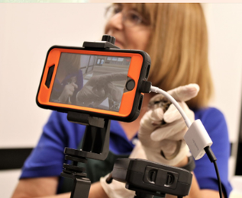
VIRTUALLY WILD! TEXAS
Bringing Nature to Students Across Texas
  Live, TEKS aligned, interactive virtual field trips with scientists & conservationists
  Designed for 2nd–5th grade
  Explore wildlife, habitats, water, and careers in natural resources
  Over 18,000 students reached since 2016
  Encourages youth to experience nature, become environmental stewards, and consider conservation careers
TFSWEB.TAMU.EDU

Slide 9
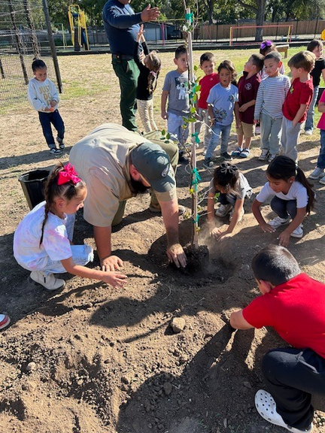

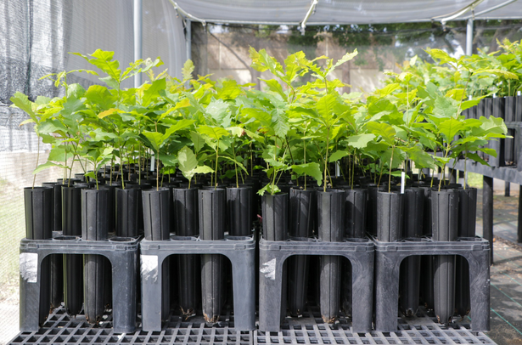
TEXAS ARBOR DAY
Celebrates the vital role of trees in our environment and community!
Key Resources:
  Tree Planting & Care Guides and How‑To Videos
  Educator Resources: Arbor Day training video, PLT
activities (Poet‑Tree, Tree Cookies, Trees as Habitats),
short-form education videos, and more!
TFSWEB.TAMU.EDU

Slide 10
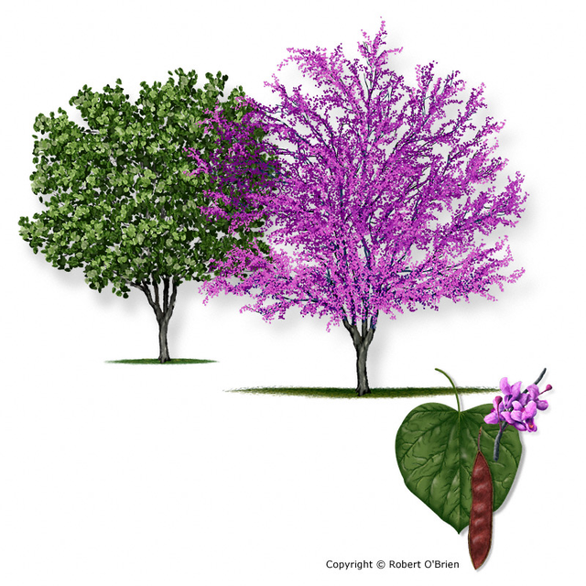
National Arbor Day
Last Friday in April
Texas Arbor Day
First Friday of November
Houston Arbor Day
4th Saturday in January
TFSWEB.TAMU.EDU
Notes:
The U.S. National Arbor Day is celebrated during the last Friday of April. However, in Texas, this is well past the ideal planting window for trees, as our climate at this time is much warmer than the rest of the country. To give young trees the best chance of survival, we general plant in the late fall and winter (between Halloween and Valentine’s Day). As such, Texas Arbor Day is celebrated on the first Friday of November. Houston also recognizes a city-wide Arbor Day on the 4th Saturday of January. All that being said— there are plenty of opportunities throughout the year to celebrate Texas trees and forests!

Slide 11
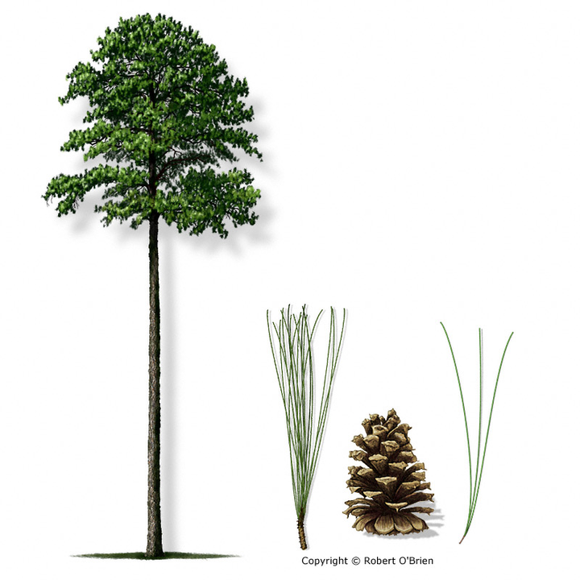
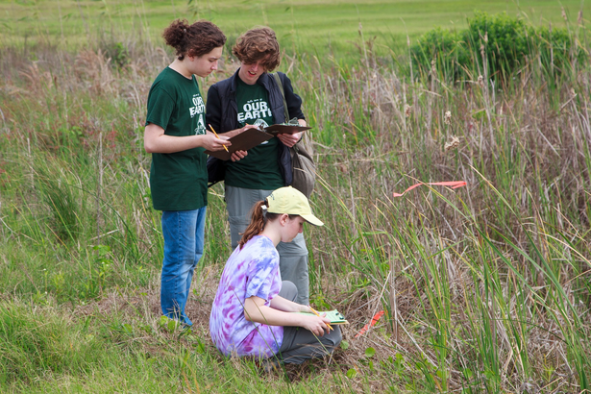
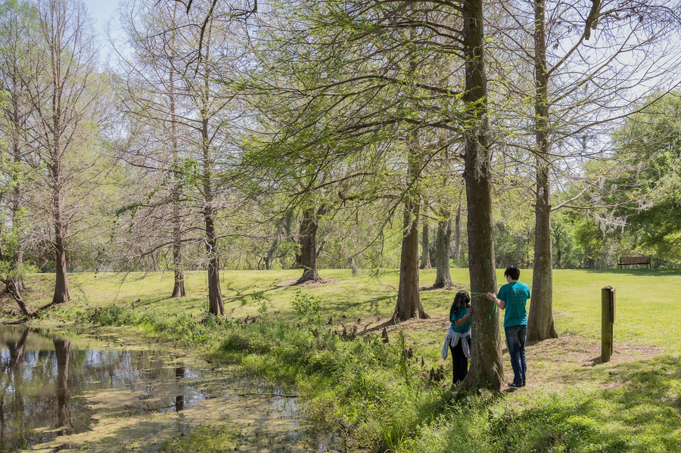
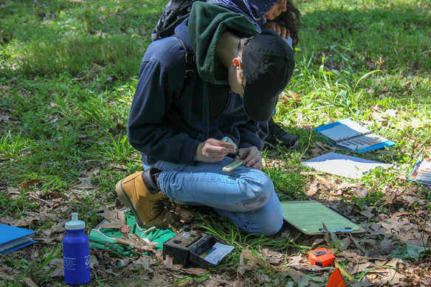
TEXAS ENVIROTHON
State academic environmental competition for high‑schoolers
  Focuses on real‑world natural resource challenges through hands‑on learning, research, & field science.
  Winning teams advance to compete at the North American Envirothon.
Forestry, Soils/Land Use, Aquatic Ecology, Wildlife, & Current Issue.
  Includes field-based testing and an oral presentation proposing solutions to complex environmental problems.
  Encourages collaboration, scientific reasoning, and communication skills.
TFSWEB.TAMU.EDU

Slide 12
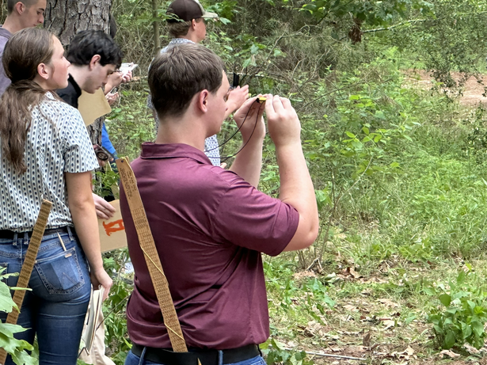

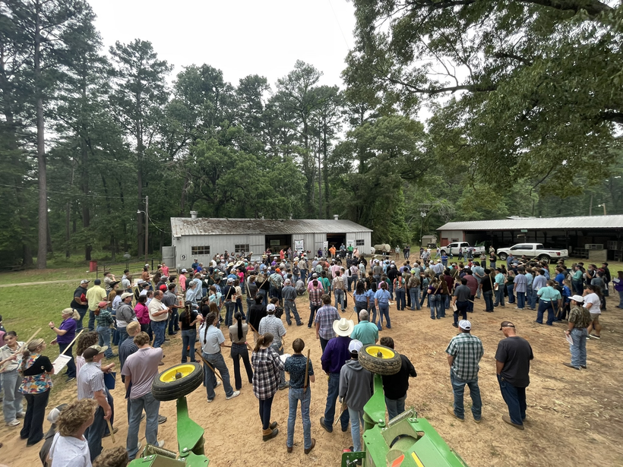

TEXAS WOODLANDS CLINIC
Texas forestry competition for 4-H and FFA youth.
Highlights value of well‑managed forests, teaching methods of developing and managing woodlands for both habitat & production.
  Species ID, site evaluation, best management practices, plot analysis for production and timber–forage–wildlife relationships.
  Exposure to forestry & forest‑management careers.
TFSWEB.TAMU.EDU

Slide 13


HOUSTON AREA URBAN FORESTRY COUNCIL
  HAUFC was formed in 1986 with the mission of providing a forum where the different interests involved in urban forestry could come together to develop programs for an enhanced urban forest in the greater Houston area
    Online resources on why, where, and what to plant, tree care, tree care and diseases, local ordinances
    Annual Tree Planting Competition
    Workshops for tree care professionals
      Bilingual Safety Workshop
      ISA Certified Arborist Prep Course
TFSWEB.TAMU.EDU

Slide 14

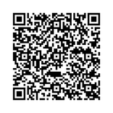
TEXAS PARTNERSHIP FOR FORESTS & WATER
  Statewide collaboration to increase communication and cooperation across the forest, water, corporate, and conservation sectors.
    45+ partnering state and federal agencies, water utilities, corporations, local government, landowners, and conservation organizations
  Partnership meetings every other month, Forests & Water Forum every 2 years
If you are interested in receiving the TPFW Newsletter or joining the Partnership, please contact TPFW@tfs.tamu.edu
TFSWEB.TAMU.EDU
Notes:
Our work in sustainable forestry also includes working to connect stakeholders invested in conserving and improving drinking water quality. The Texas Partnership for Forests & Water was established at the inaugural Texas Forests & Drinking Water Forum hosted by Texas A&M Forest Service and Texas Rural Water Association at Lake Conroe in 2015. At this meeting, 50 professionals in the forest and water sector agreed on the importance of healthy forests to the state’s water supply. There was strong consensus that maintaining or expanding healthy forests in watersheds was a cost effective and appealing strategy to help ensure clean, abundant, supplies of water, and that continued dialogue and collaboration was essential. Since its establishment, TPFW meets regularly (virtually every other month) to coordinate activities and advance forest and water demonstration projects.
In September, the partnership held the 2025 Texas Forests & Water Forum in Conroe. This event included a field visit to the Cook's Branch Conservancy and a full day of speakers and a panel discussing watershed modeling related to forestry, forest/water success stories, financial opportunities related to sustainable forestry and water conservation, and updates on the 89th Legislative session.
This partnership is made stronger by the diverse range of professionals and organizations that are involved. If you're interested in learning more about the Partnership, you can check out our website or contact Julia Schmidt, Texas Partnership for Forests and Water Coordinator.

Slide 15
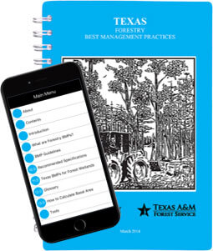
FOREST/WATER EDUCATION AND OUTREACH
  Workshops on Texas Forestry Best Management Practices (BMPs)
    Texas Riparian & Stream Ecosystem Workshops (Texas Water Resources Institute)
    Silvicultural BMP workshops
      Can be expanded out for urban forestry operations
    Forest landowner education
      Site visits and consultations
  BMP demonstration areas, factsheets, forest/water one-pagers
Texas Forestry Best Management Practices Handbook
TFSWEB.TAMU.EDU
Notes:
Our work also involves engaging the general public in understanding the importance of trees and forests in water quality and quantity.
We regularly partner with other organizations to deliver education to landowners, professionals, and other interested stakeholders.
The Texas Water Resources Institute (TWRI) coordinates "Riparian and Stream Restoration" workshops open to the public to support existing WPP efforts (including locally a workshop in Matagorda). At these trainings, we present on the forest/water relationship and cover best practices that are implementable to stakeholders on small, medium, and large scales. We also provide attendees with online resources available through the Texas Forest Info webpage, including "PlanMyLand", a GIS tool for identifying sensitive areas and locating appropriate areas for various forestry BMPs. Similar workshops would be valuable within the Greater Houston region, especially as the area continues to expand and develop.
We also distribute onepagers and other factsheets related to the importance of forests to water quality and quantity, BMPs, riparian species lists, etc. We often display these at various community events that we table at.

Slide 16
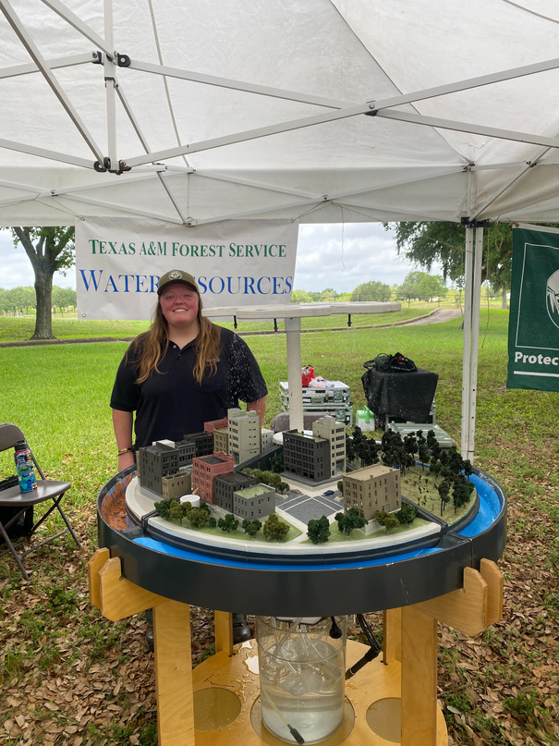
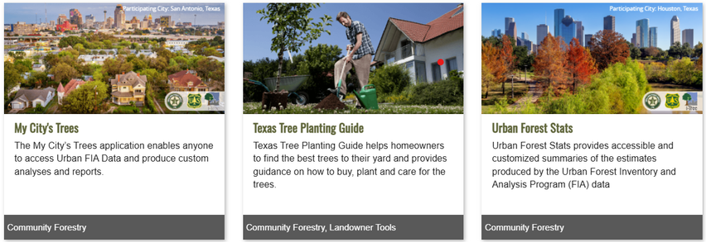

FOREST/WATER EDUCATION AND OUTREACH
  Field days, fairs, and trade events
  University outreach
    SFA and TAMU Forestry Labs
    Career Fairs, Internships
  Newsletters, media, marketing materials
Cassidy Ince, Texas A&M Forest Service, shows off a surface runoff model at the Houston Water Works Festival (2022).
Texas Forest Information Portal
TFSWEB.TAMU.EDU
Notes:
We regularly partner with various educational institutions, such as SFA and TAMU, to deliver field education to students studying forestry. Additionally, we partner with outside organizations to deliver childhood education related to conservation in formal and informal settings.

Slide 17
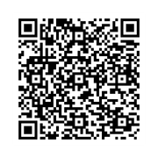
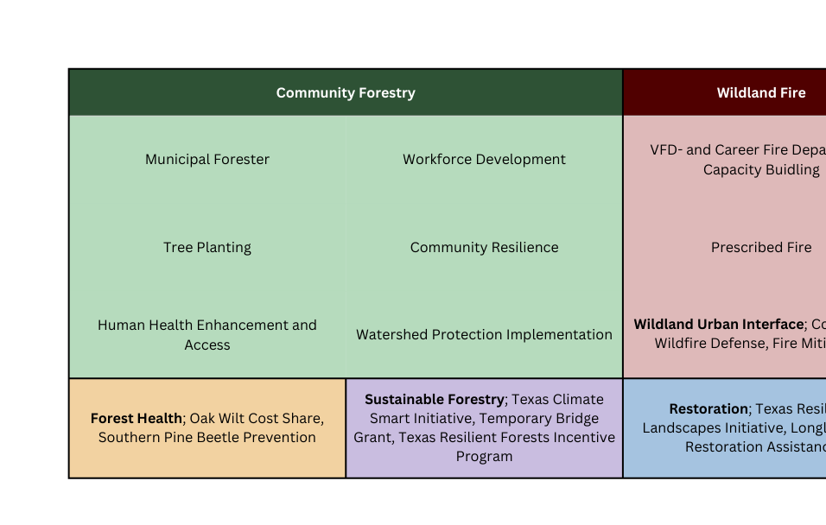
TEXAS A&M FOREST SERVICE GRANTS
TFSWEB.TAMU.EDU

Slide 18
Jaden Kelly
Conservation Education
Program Specialist
jaden.kelly@tfs.tamu.edu
(936) 689-5842
Sam Hill
Water Resources
Woodland Ecologist
sam.hill@tfs.tamu.edu
(832) 260-5866
CONSERVE. PROTECT. LEAD.

