Slide 1
SOTB Feedback Summary
Erin Kinney and Jennifer Irving
HARC
June Subcommittee Meetings 2026

Slide 2
State of the Bay, 5th Edition
Created by GBEP Stakeholders for GBEP Stakeholders
Summarizes environmental datasets and information that will improve and facilitate management of Galveston Bay through the Galveston Bay Plan
Serves as a reference for scientists, natural resource managers, outreach specialists, etc.
The 5th Edition will focus on ~3 Priority Issues and how they impact/are impacted by Galveston Bay and its watershed

Slide 3
State of the Bay, 5th Edition
Created by GBEP Stakeholders for GBEP Stakeholders
Summarizes environmental datasets and information that will improve and facilitate management of Galveston Bay through the Galveston Bay Plan
Serves as a reference for scientists, natural resource managers, outreach specialists, etc.
The 5th Edition will focus on ~3 Priority Issues and how they impact/are impacted by Galveston Bay and its watershed
How do you want to use the SOTB?
What are the most pressing/important issues facing Galveston Bay in 2026?

Slide 4
Feedback Summary
Total number of comments (some individuals submitted multiple comments) = 58
Total number entities/ individuals with comments = 32
State of the Bay Comments fell into three broad themes
  Topics
  Additional data
  Purpose, usability and features of SOTB Website
Some comments were about collaboration or ideas for things GBEP should do or prioritize and NOT directly relevant to the SOTB
  These have been shared with GBEP

Slide 5
Comments about Purpose, Features and Usability
Project Database
SOTB platform to showcase GBEP projects?
Small updates with links to RMD or outside studies
Section that links to other plans and projects
News tab
Why isn’t the SOTB Public facing?
Include a “What to do with this information section”
  Section for educators?
Highlight/ bold key phrases to draw the reader in
Add/ keep section on data sources and citations
Should we forecast into the future?

Slide 6
Comments about Purpose, Features and Usability
Project Database
SOTB platform to showcase GBEP projects?
Small updates with links to RMD or outside studies
Section that links to other plans and projects*
News tab
Why isn’t the SOTB Public facing?
Include a “What to do with this information section”
  Section for educators?
Highlight/ bold key phrases to draw the reader in
Add/ keep section on data sources and citations
Should we forecast into the future?
Resources/Links

Slide 7
Comments about Purpose, Features and Usability
Project Database
SOTB platform to showcase GBEP projects?
Small updates with links to RMD or outside studies
Section that links to other plans and projects*
News tab
Why isn’t the SOTB Public facing?
Include a “What to do with this information section”
  Section for educators?
Highlight/ bold key phrases to draw the reader in
Add/ keep section on data sources and citations
Should we forecast into the future?
Resources/Links
Different Purpose/Scope

Slide 8
Comments about Purpose, Features and Usability
Project Database
SOTB platform to showcase GBEP projects?
Small updates with links to RMD or outside studies
Section that links to other plans and projects*
News tab
Why isn’t the SOTB Public facing?
Include a “What to do with this information section”
  Section for educators?
Highlight/ bold key phrases to draw the reader in
Add/ keep section on data sources and citations
Should we forecast into the future?
Resources/Links
Different Purpose/Scope
Can do!
Scope?

Slide 9
Comments About Other Sources of Data
Citizen science data (TX steam team, Nurdle Patrol, MDMAP)
SWQIMS discharge data
H-GAC Clean Rivers Basin Summary Report (only SWQIMS data)
Texas Invasive Species Institute
Oyster farming & mariculture
Wetland Action Mapping Data
H-GAC Clean Rivers Basin Summary Report
Silviculture BMP data

Slide 10
Comments About Potential Topics
Land use change
Microplastics/ Trash
Emerging topics (broadly)
  Describe work being done in other NEPs
  Chlorinated and fluorinated compounds (PFAS)
Upstream projects/ development/ population growth
How GBEP fits with other plans
Shoreline erosion/ marsh migration
  Also a species component
  Shoreline hardening projects (map)
Human uses and impacts
  A “people” section (public use and public access such as tourism)
Gaps and future research needs
Dolphins
Public outreach & volunteer engagement
BMPs and other “upstream” projects
  Role of coastal prairies (and silviculture) in supporting bay health
Human health (2 related comments)
  Focus on Vibrio
  Need to understand role of TDSHS

Slide 11
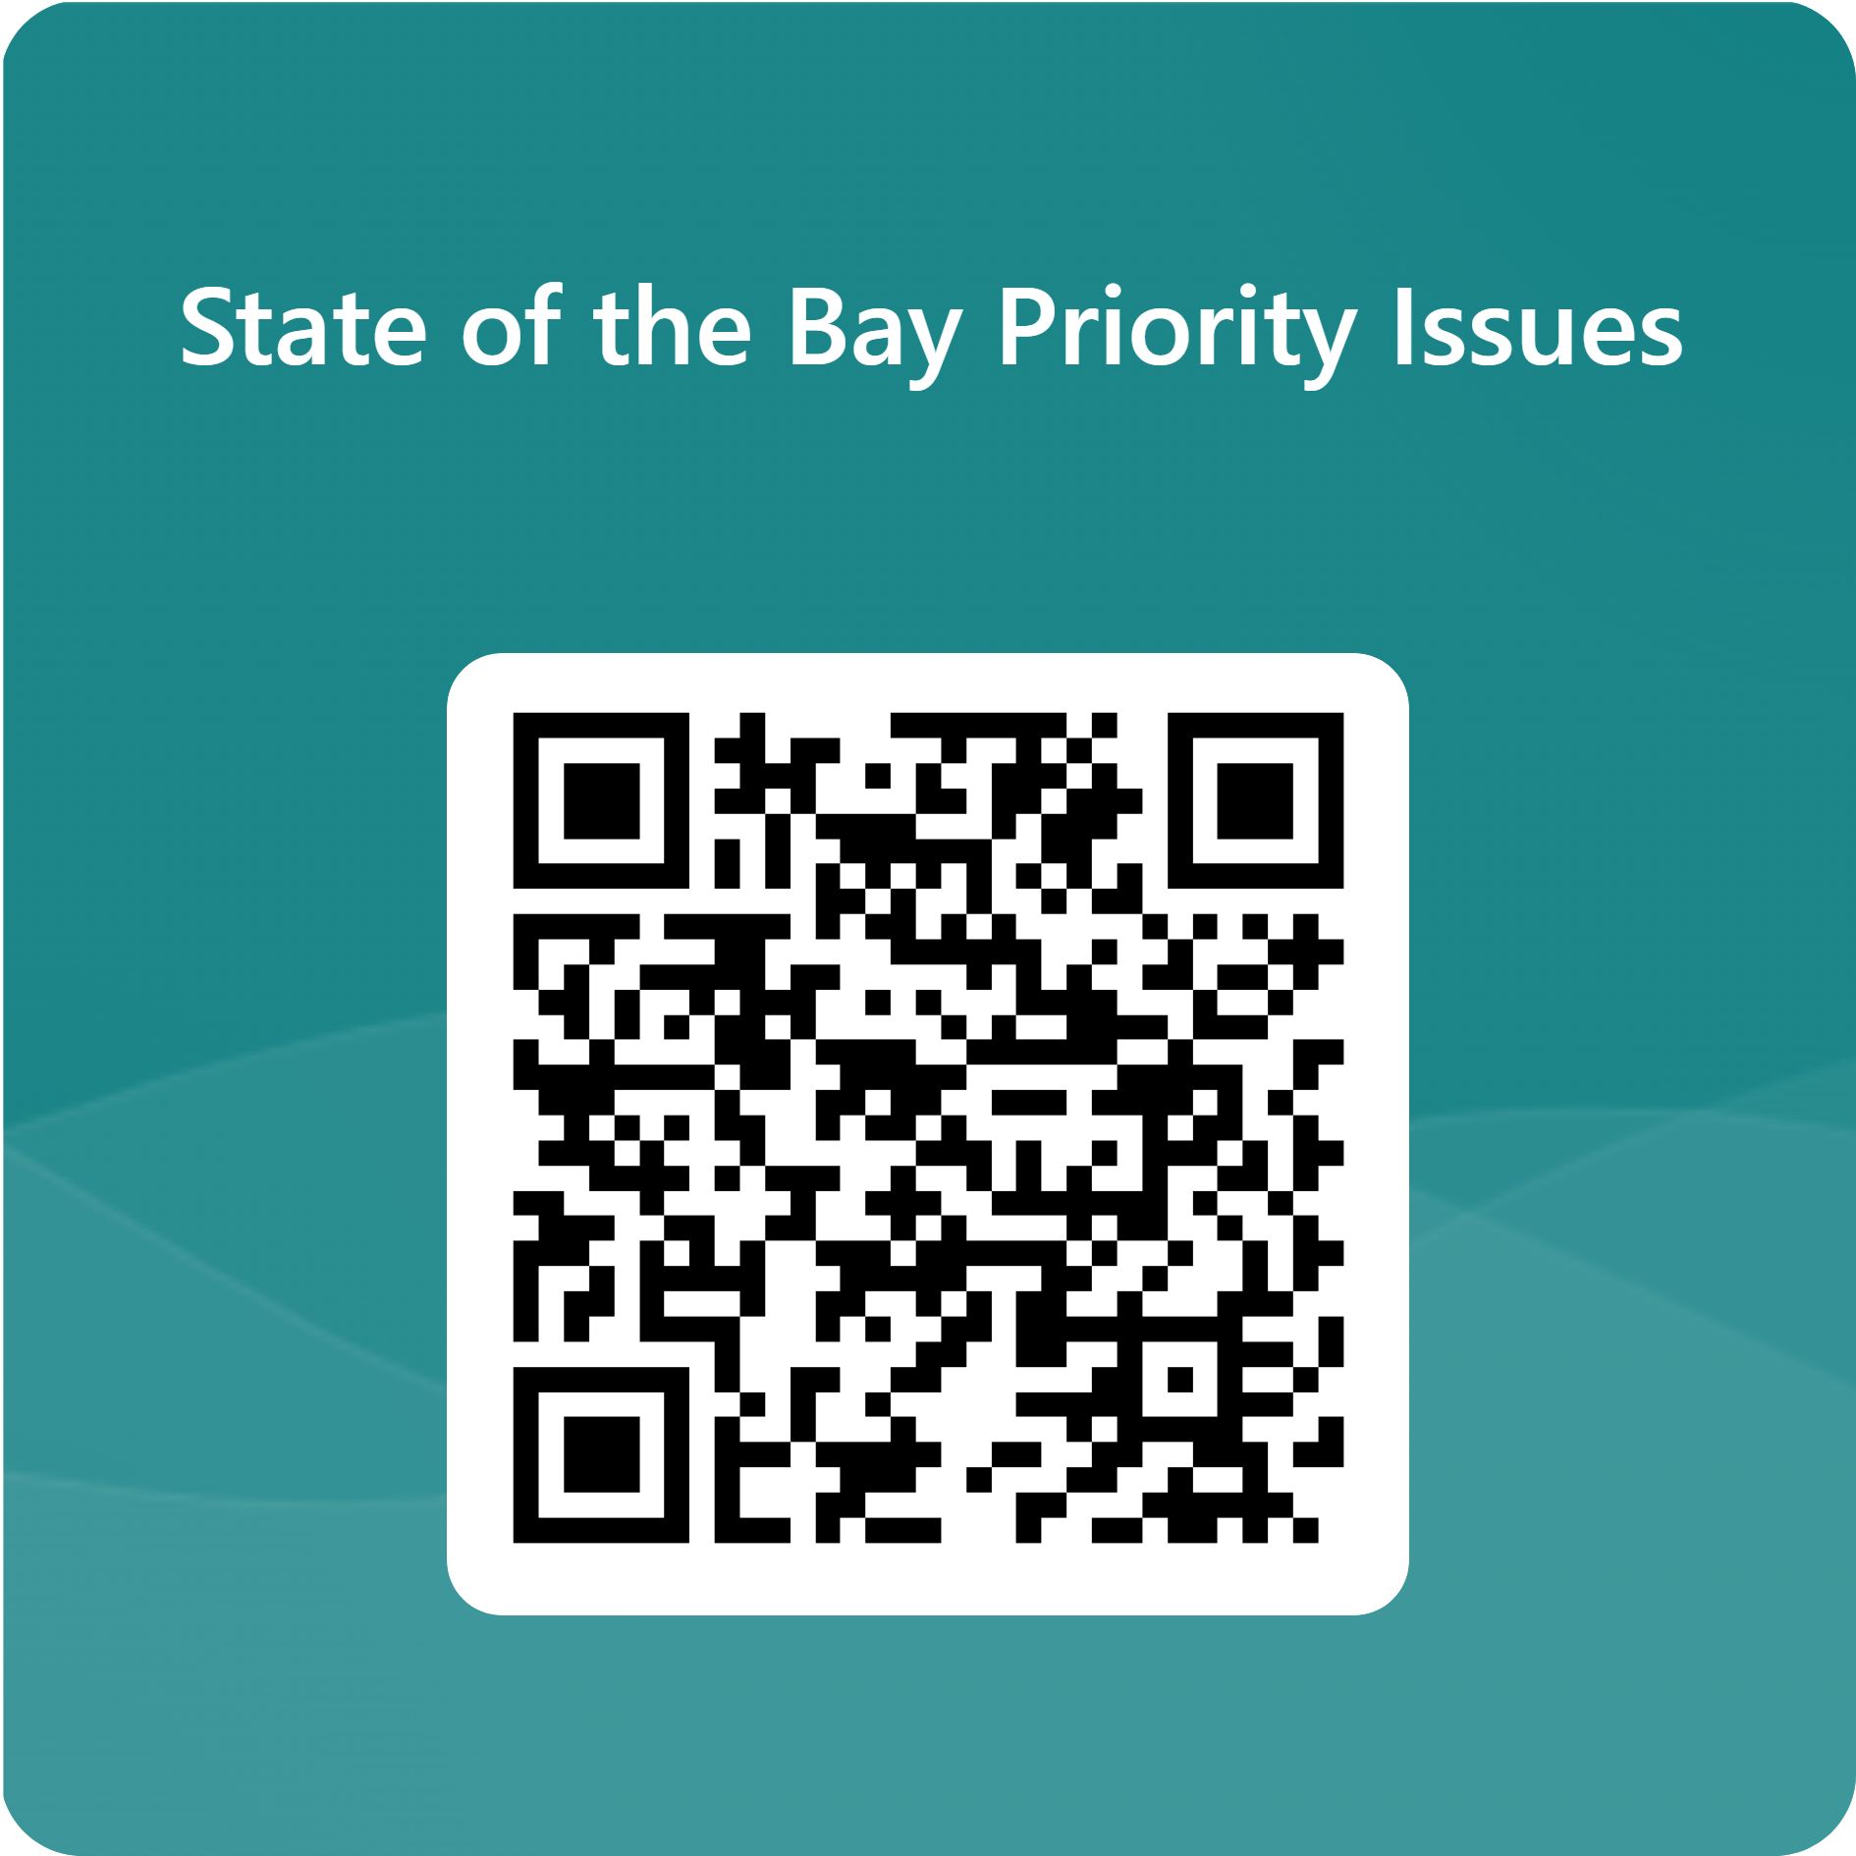
Rank Your Top 3 Priority Issues
State of the Bay Priority Issues – Fill out form

Slide 12
State of the Bay Stakeholder Feedback Process
Pre-Workshop Homework
Review SOTB
Identify:
Workshop + Feedback Form
Generate priority topics for initial ranking
Submit feedback:
June Subcom. Meetings
Finalize the list of priorities for SOTH, 5th Edition
Topics
Data
Publications
Live (paper/ Teams chat)
Post-Meeting (QR code/ email)
Present results of workshop and feedback forms
Dec. Subcom. Meetings*
Present draft SOTB Outline
Focus on Priority Themes

