Slide 1
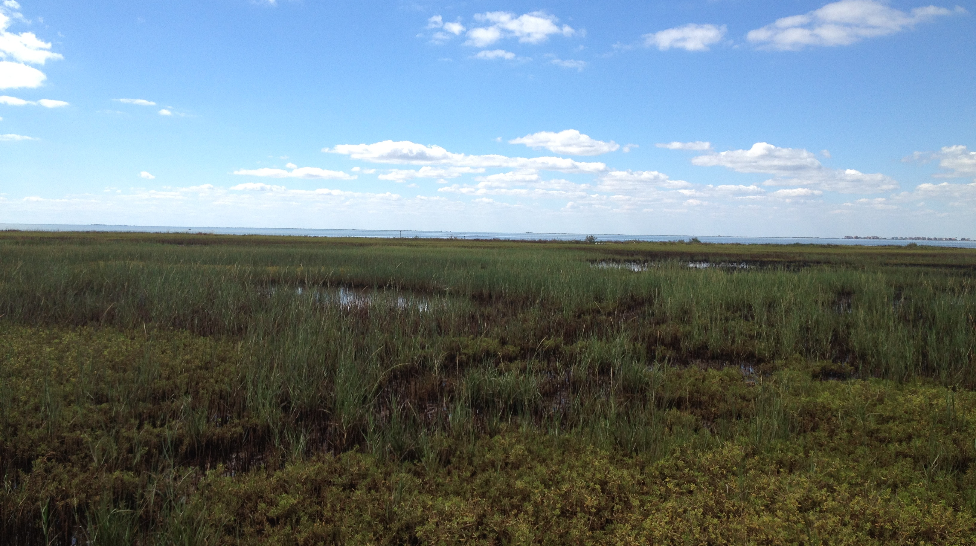


Coastal Diamonds: A History of Diamondback Terrapin in Texas
Mandi Gordon
Associate Director, Research Programs
Environmental Institute of Houston
University of Houston – Clear Lake
2700 Bay Area Blvd.
Box 540
Houston, TX, 77058
gordon@uhcl.edu; 281-283-3794
Galveston Bay Council Quarterly Meeting; Galveston, Texas; April 15, 2026

Slide 2
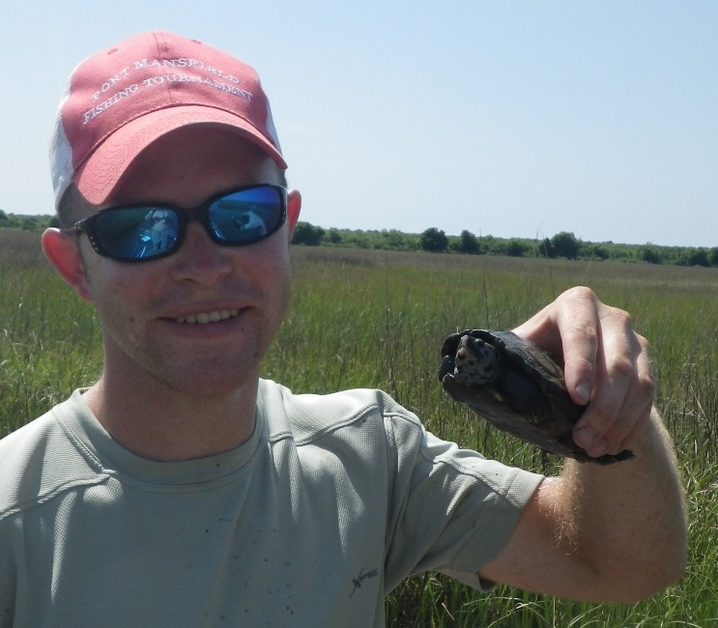
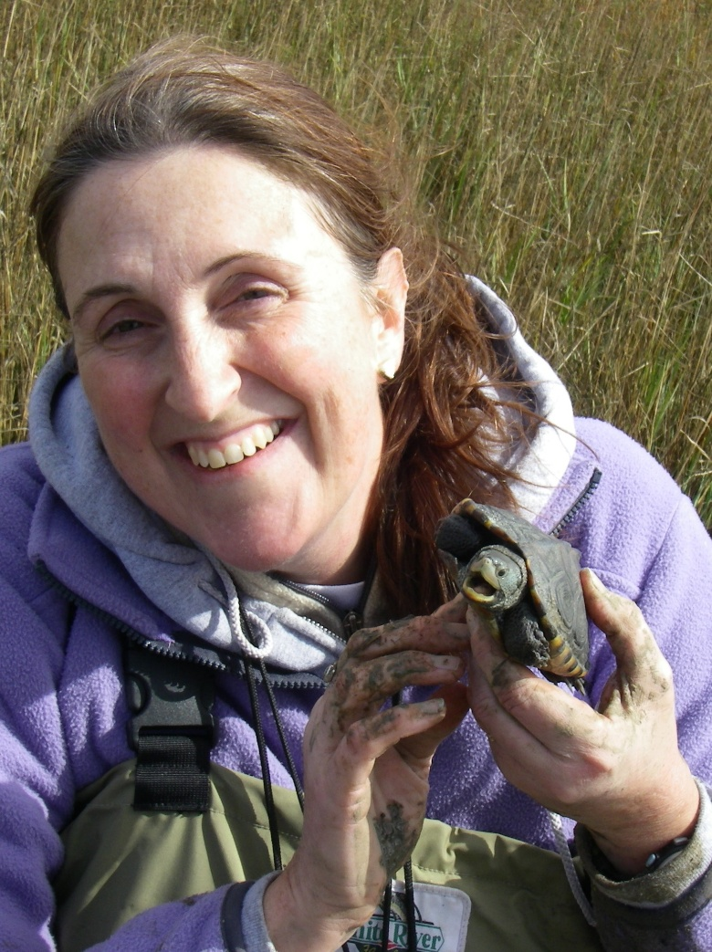
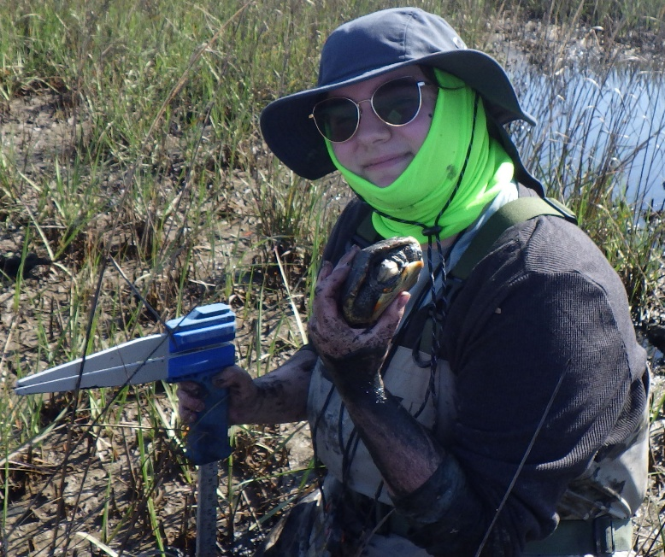
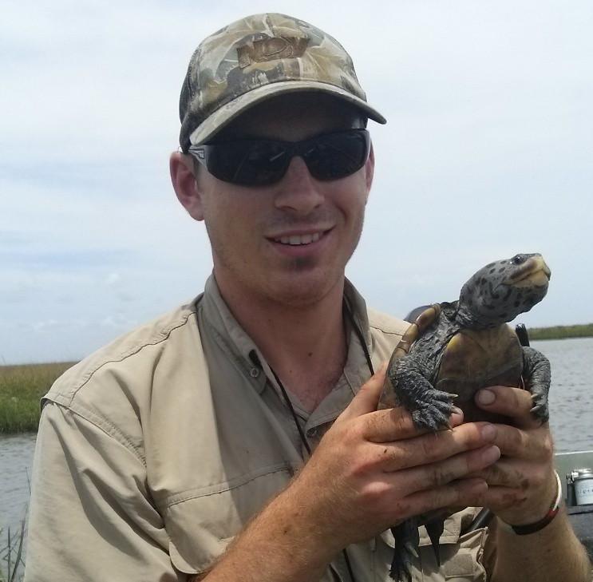
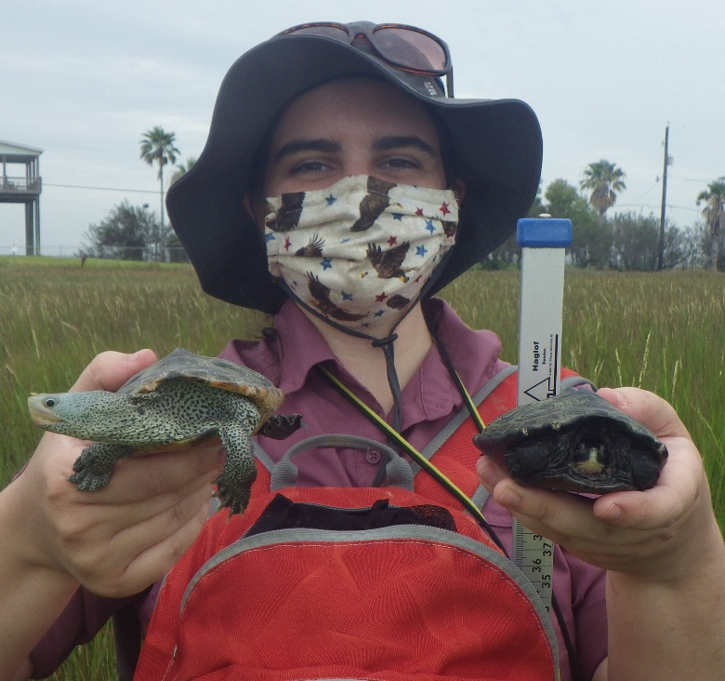
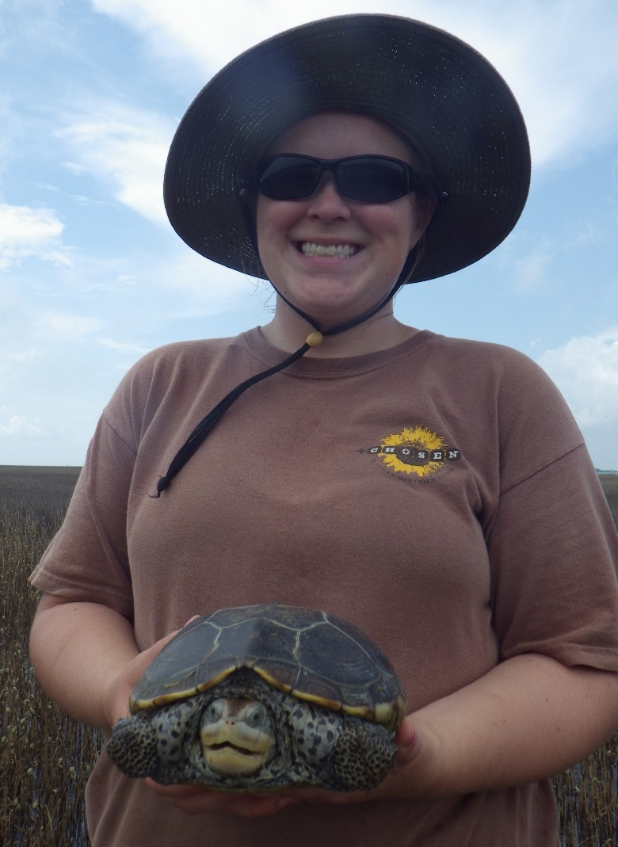

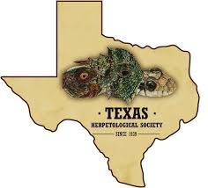



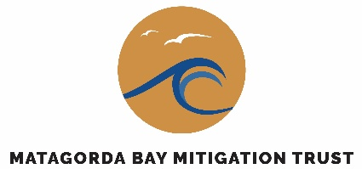
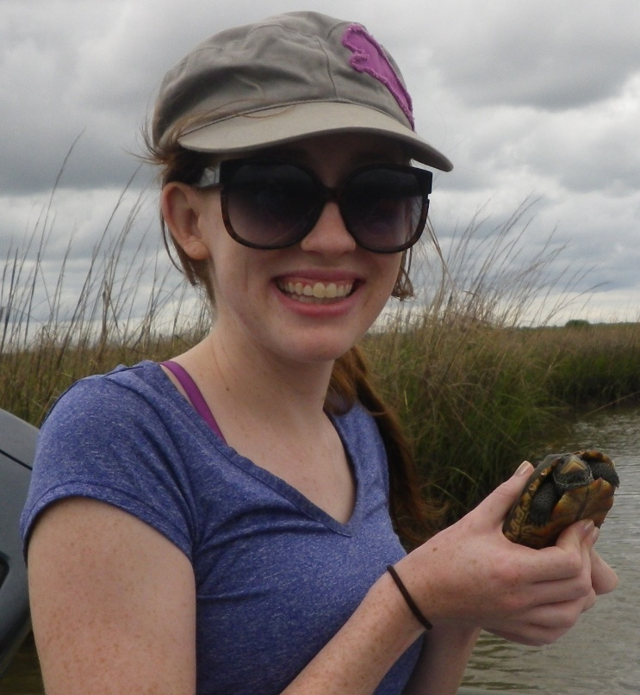
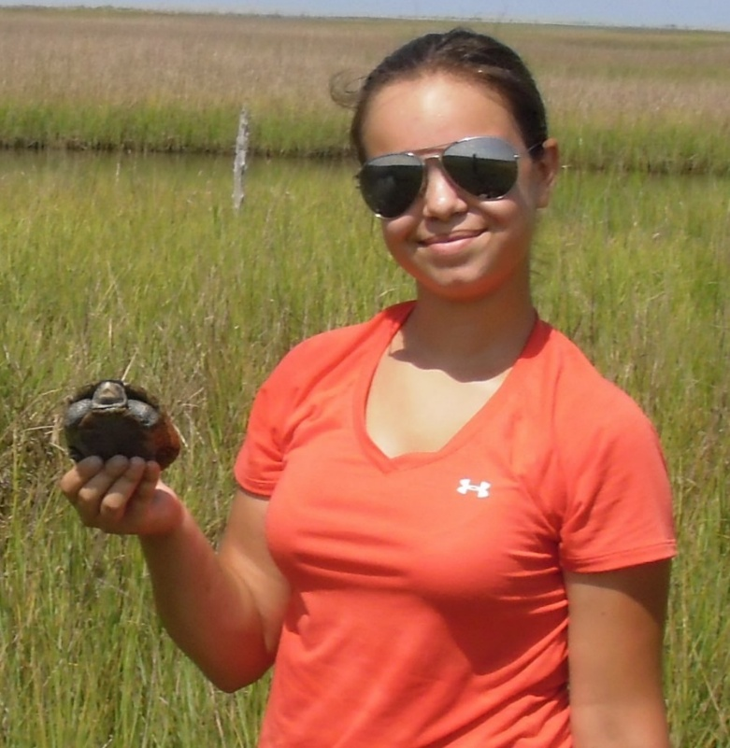
Acknowledgements
Field Personnel: countless graduate students, staff members, volunteers, project partners, and stakeholders
Funding Sources: Houston Zoo, U.S. Fish and Wildlife Service, Texas Parks and Wildlife, Texas SeaGrant, Texas Herpetological Society
Permitting & Site Access:
  TPWD permits SPR-0504-383 and SPR-0321-026
  Multiple IACUC protocols
  NWR Special Use permits
  The Nature Conservancy, Galveston Bay Foundation and other private landowners

Slide 3
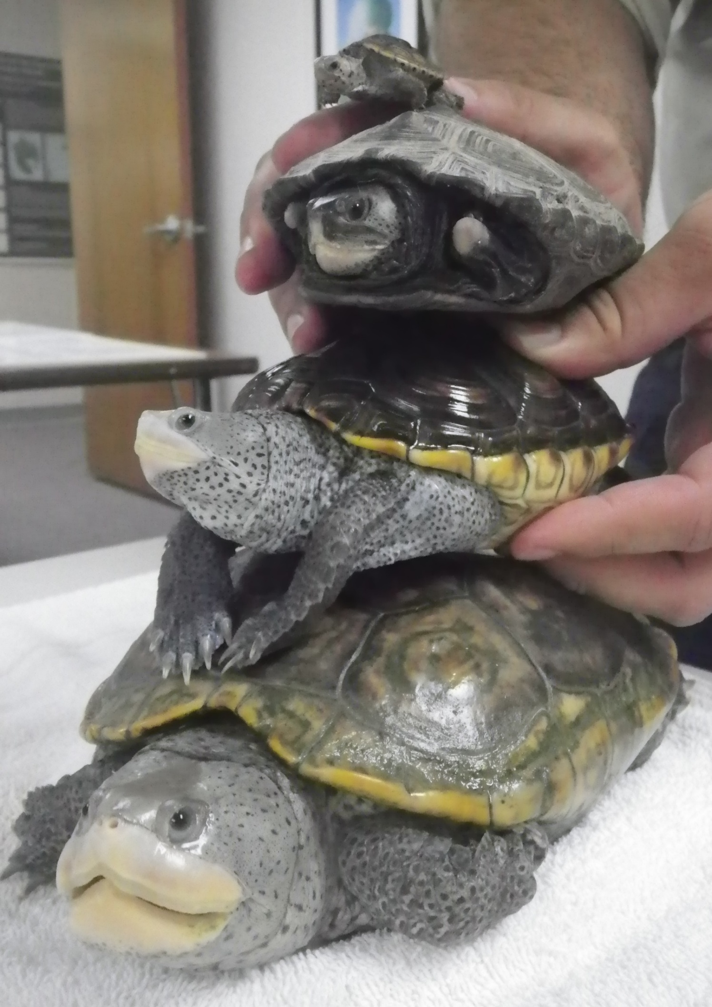
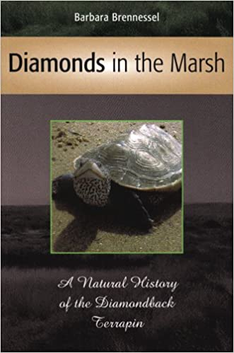
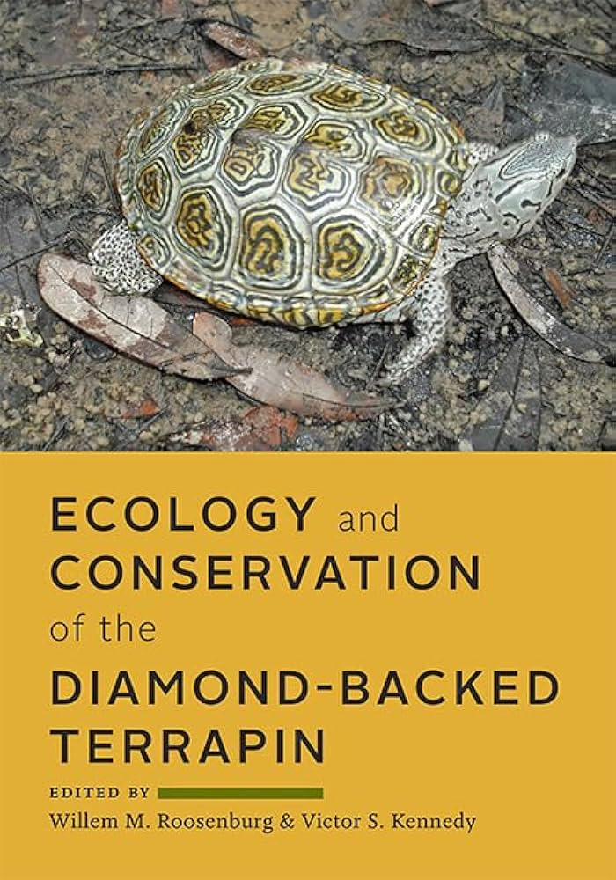
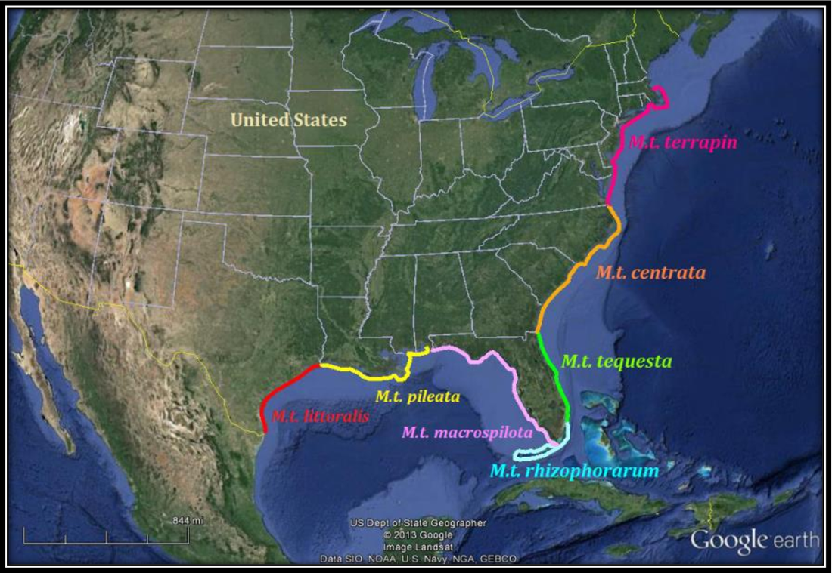

What is a Terrapin?
Glenos 2013
Notes:
Marsh dwelling species
Sexual dimorphism
Melanism in males
Megacephaly in females
Tiny turtle at top of stack is “Kirby”
Range from the northeast to middle-Texas coast, including the Bahamas. Seven subspecies throughout the range. Malaclemys terrapin littoralis is specific to Texas (with some reports of populations along the border with Louisiana).
Highly recommend “Diamonds in the Marsh”

Slide 4
A Timeline of Terrapin History (Galveston Bay)
Mid-late 1800’s
M. terrapin sold at local seafood markets in Galveston and Houston⁶
1902
Last known report of turtles sold in Galveston
(4,300 lbs.)¹³⁻¹⁴
- - - - - - - - - - - - - - - - - Texas terrapin transported to east coast for propagation studies¹⁵
1929
The Great Depression begins; terrapin stew becomes prohibitively expensive¹⁹
1996
Terrapin named “globally near-threatened” by IUCN²⁸
1700’s
“Terrapin” in the diet of Coahuiltecan (Venado) indigenous people²
1920
Height of terrapin stew craze; market price averaged ~$90/dz.^{6,17-19}
1841
“100’s” of M. terrapin collected in Galveston Bay over a few hours⁴
Late 1800’s
Beginning of commercial oyster harvesting on the Texas Gulf coast⁸⁻¹¹
1969
Oyster shell dredging banned²²⁻²⁶
1895
Texas legislature prohibits harvest of terrapin by drag seine or set net from Apr-Sep in select waters¹²
1916
All but 12 Texas terrapin returned from propagation studies¹⁵⁻¹⁶
2002
First nest documented on Texas coast since 1960s²⁹
Late 1500’s
Earliest account of “terrapin” on east coast¹
1967
Oyster shell dredging peaks; 50.7% of nationwide mining exclusive to Texas²¹
Mid-late 1800’s
Oyster shells heavily mined and used as ballast for road base or railroad tracks in Galveston Bay area⁷
1793
Schoepff describes Malaclemys terrapin³
1905
Hay describes the Texas subspecies littoralis¹⁶
1920
Prohibition; inaccessibility of brandy attributed to the collapse of the terrapin stew industry^{18,20}
1994
Terrapin a candidate species for ESA protections²⁷
¹Brennessel 2016
²Kohout 2010
³Schoepff 1792
⁴Hooten 1847
⁶Shaffer et al. 2008
⁷Doran 1965
⁸Tucker 1929
⁹Galstoff 1931
¹⁰Hoffstetter 1977
¹¹Henson 1993
¹²Texas Legislature 1895
¹³Townsend 1899
¹⁴Doughty 1984
¹⁵Barney 1922
¹⁶Hay 1904
¹⁷Coker 1920
¹⁸Martin1989
¹⁹Morise 2010
²⁰TPWD 2007b
²¹Arndt 1976
²²Hoffstetter 1960
²³Benefield 1976
²⁴Garcia 1979
²⁵Crowe 1984
²⁶Gallaway 2011
²⁷Beattie 1994
²⁸Outerbridge 2014
²⁹Hogan 2003

Slide 5
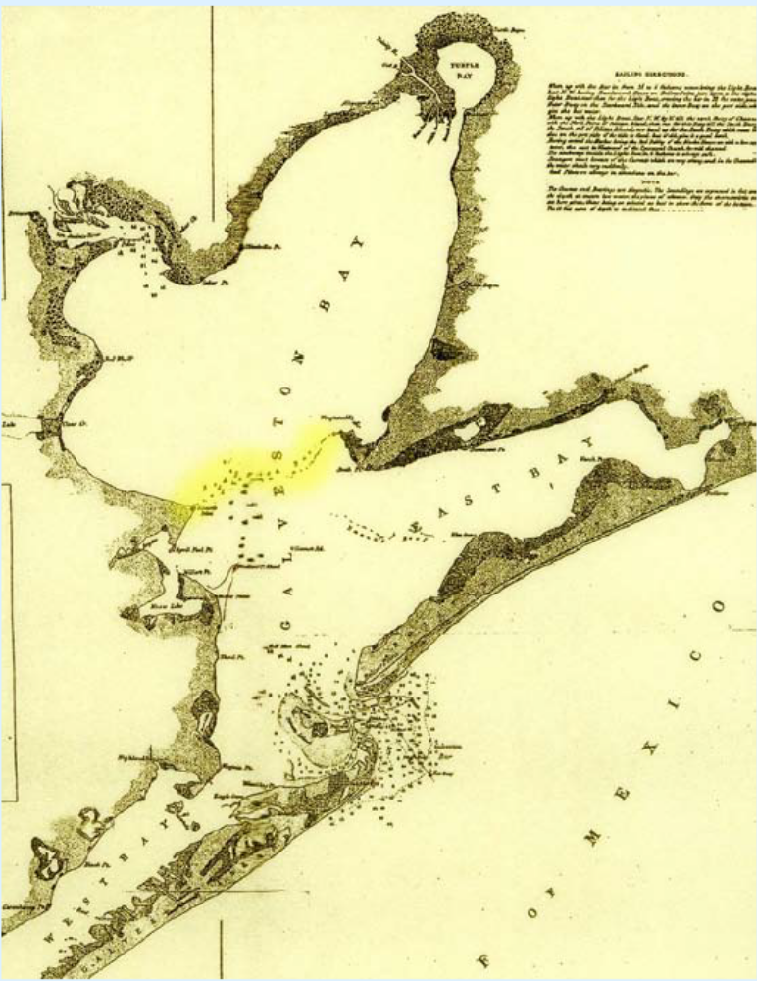
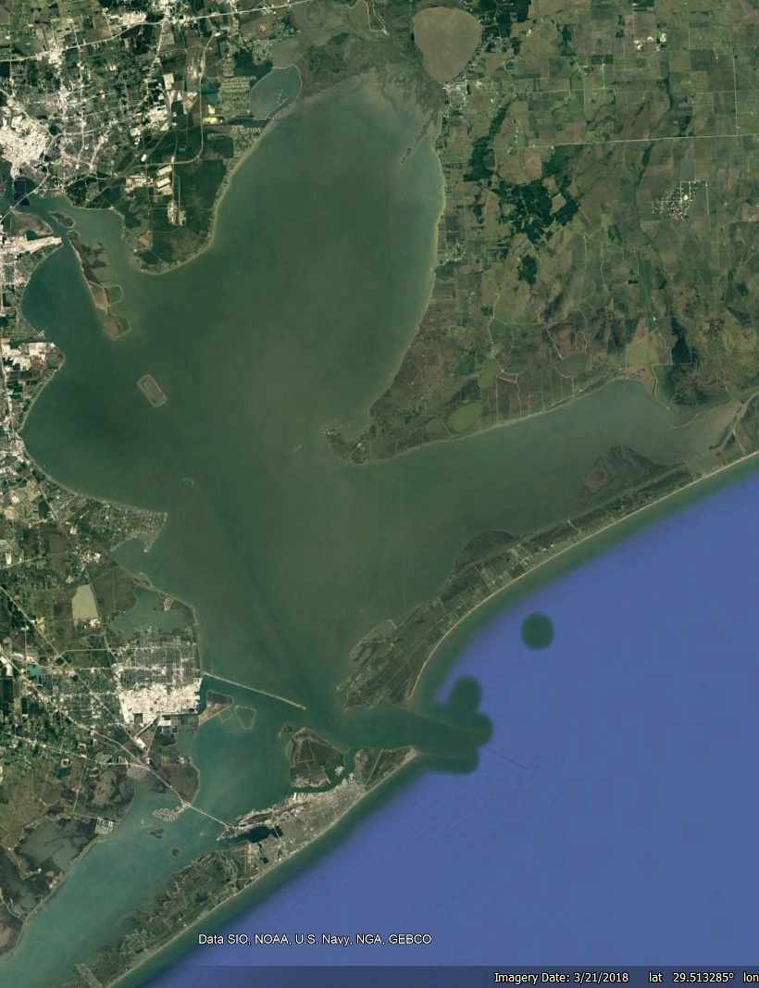
Effects of Oyster Harvesting in Galveston Bay
1851
2016

Slide 6
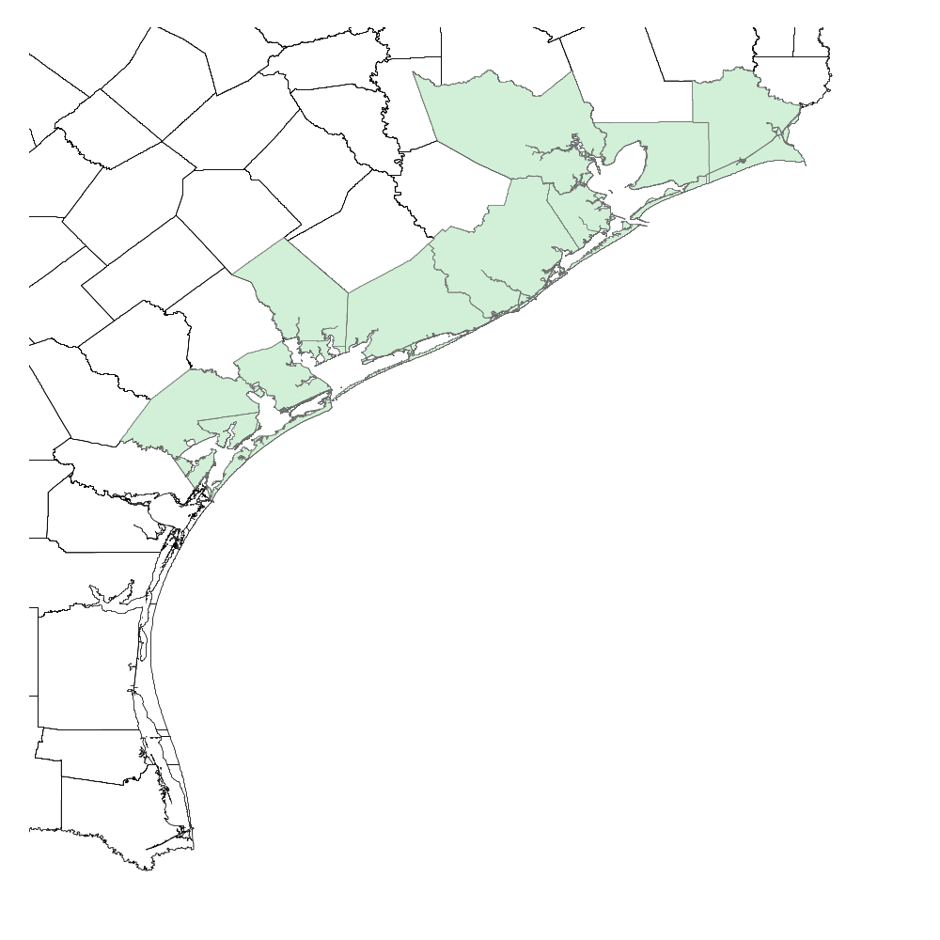
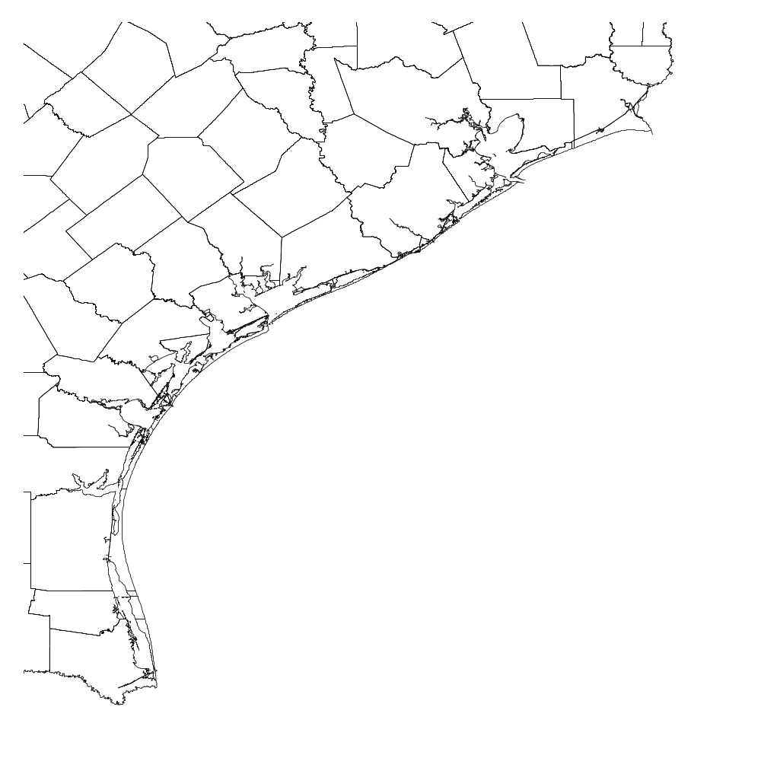
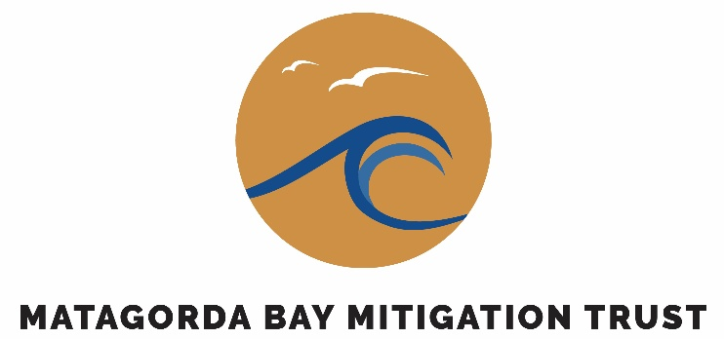


UHCL-EIH Terrapin Monitoring Program
Within our 18th year (2008-present)
Covers 9 counties and 5 major bays
Nearly 1,200 turtles state-wide
7 grant funded studies (2008-2015; 2016-2017; 2023-2027)
  Population Study on Deer Island (HZA 2008)
  Mid-Coast Complex Surveys (USFWS 2009)
  Population Status & Demographics (Sea Grant 2010-2012)
  By-Catch Study (TPWD & USFWS 2012-2014)
  Mid- & Upper Texas Coast Surveys (TPWD SWG 2014)
  Continued Monitoring (THS 2016-2017)
  Microplastic Contaminants (MBMT 2023-2027)
https://www.uhcl.edu/environmental-institute/research/current-projects/terrapin-life-history
Notes:
We’re currently entering our 14th year of this program. To date, our monitoring efforts have spanned 9 counties and five major bay systems. We have over 1,000 individually marked turtles state-wide and our efforts have been supported by 6 grant funded studies. Over the years, we have produced 5 graduate theses focusing on abundance and movement, activity patterns and habitat selection, genetic variation, nesting ecology, and diet, habitat, and prey availability.

Slide 7
UHCL-EIH Terrapin Monitoring Program
Within our 18th year (2008-present)
Covers 9 counties and 5 major bays
Nearly 1,200 turtles state-wide
7 grant funded studies (2008-2015; 2016-2017; 2023-2027)
6 graduate theses (2011-2015; Ongoing)
  Abundance & Movement (Haskett [Ondracek] 2011)
  Activity & Habitat Selection (Clarkson 2012)
  Genetic Variation (Glenos [Gynego] 2013)
  Nesting Ecology (George 2014)
  Diet, Habitat, & Prey Availability (Alleman 2015)
  Microplastic Accumulation in Habitats (Hammerbach 2025)
https://www.uhcl.edu/environmental-institute/research/current-projects/terrapin-life-history
Notes:
We’re currently entering our 14th year of this program. To date, our monitoring efforts have spanned 9 counties and five major bay systems. We have over 1,000 individually marked turtles state-wide and our efforts have been supported by 6 grant funded studies. Over the years, we have produced 5 graduate theses focusing on abundance and movement, activity patterns and habitat selection, genetic variation, nesting ecology, and diet, habitat, and prey availability.

Slide 8
Current and Historic Capture Rates
Average Sex Ratio (M:F) =
0.76 ± 0.051

Slide 9
Current and Historic Capture Rates

Slide 10
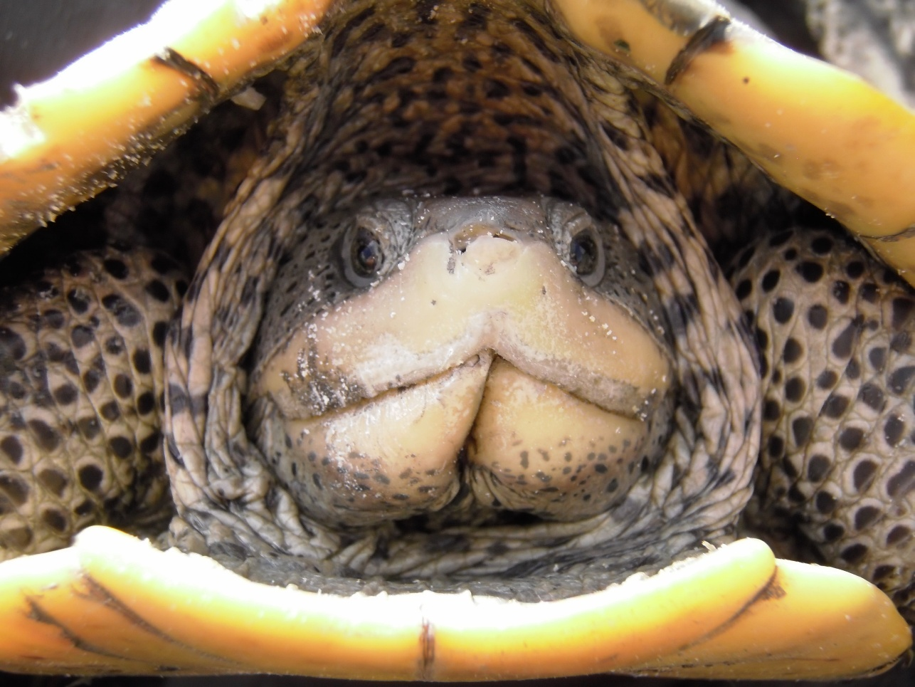
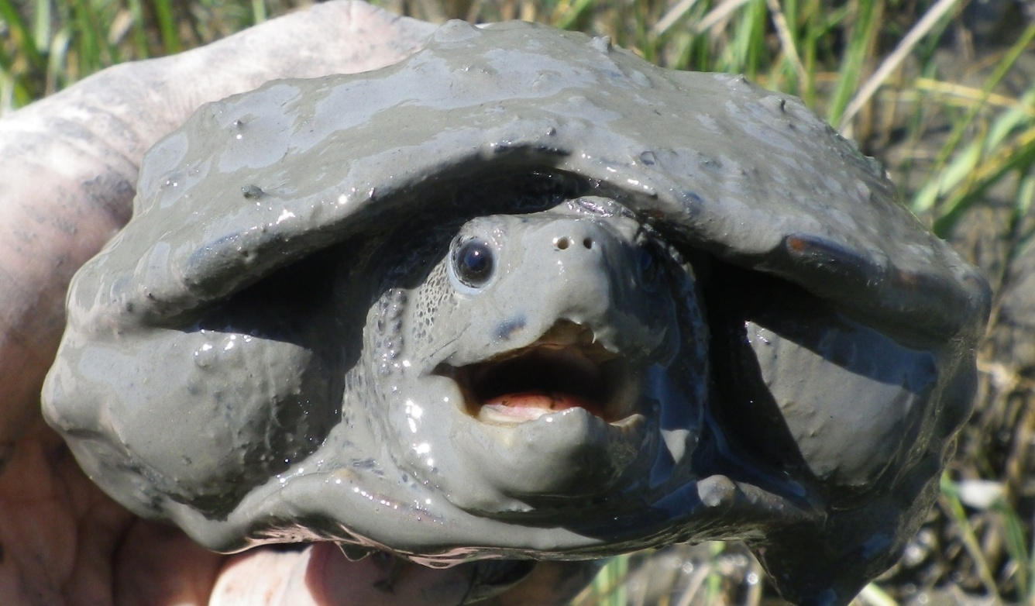
Current and Historic Capture Rates
Average CPUE =
0.40 ± 0.059 turtles/hr
TPWD SPR-0504-383
TPWD SPR-0504-383
Notes:
Since 2008, our terrapin capture rates have varied. Most of our capture events occurred between 2008 and 2013. This period coincides with weekly to monthly sampling and a large amount of grant funding. In 2014, we conducted a coast-wide monitoring study and sampled multiple habitat types, including those where terrapin were not likely to exist. Since 2015, our efforts have been reduced to bi-annual sampling and are primarily supported by our adoption fund. I don’t want to paint a bleak picture for terrapin in the state though. As our search efforts have been reduced, our catch per unit effort has stayed mostly consistent. So, it’s not that there are fewer terrapin out there, it’s that we don’t have as much time to go looking for them as we used to.

Slide 11
Current and Historic Capture Rates
TPWD SPR-0504-383
TPWD SPR-0504-383
Notes:
Since 2008, our terrapin capture rates have varied. Most of our capture events occurred between 2008 and 2013. This period coincides with weekly to monthly sampling and a large amount of grant funding. In 2014, we conducted a coast-wide monitoring study and sampled multiple habitat types, including those where terrapin were not likely to exist. Since 2015, our efforts have been reduced to bi-annual sampling and are primarily supported by our adoption fund. I don’t want to paint a bleak picture for terrapin in the state though. As our search efforts have been reduced, our catch per unit effort has stayed mostly consistent. So, it’s not that there are fewer terrapin out there, it’s that we don’t have as much time to go looking for them as we used to.

Slide 12
Current and Historic Capture Rates

Slide 13
Current and Historic Capture Rates

Slide 14
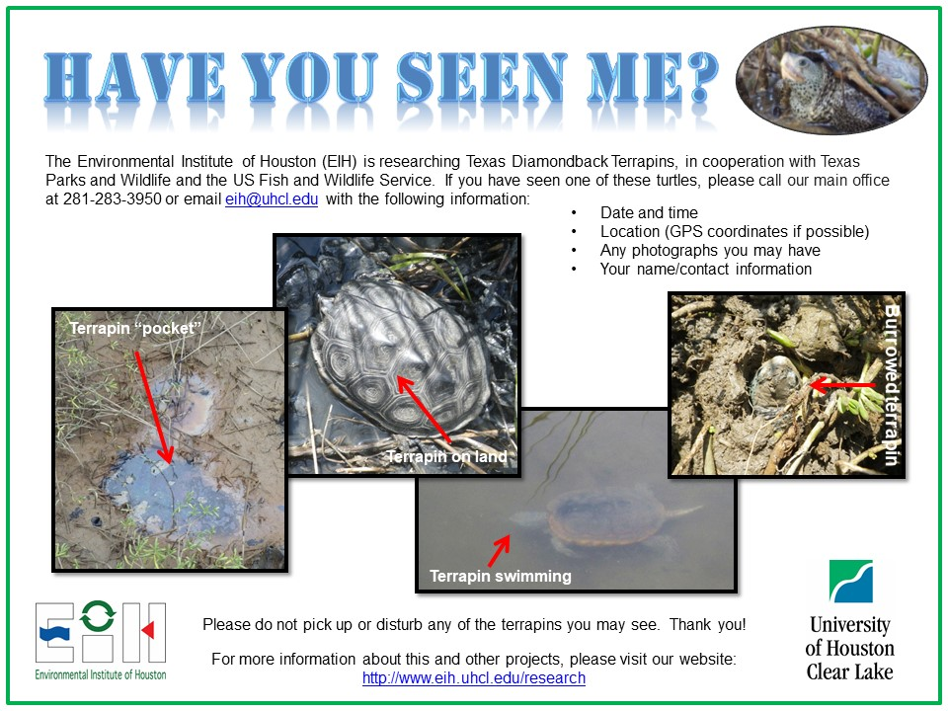
“Have You Seen Me?” Campaign

Slide 15
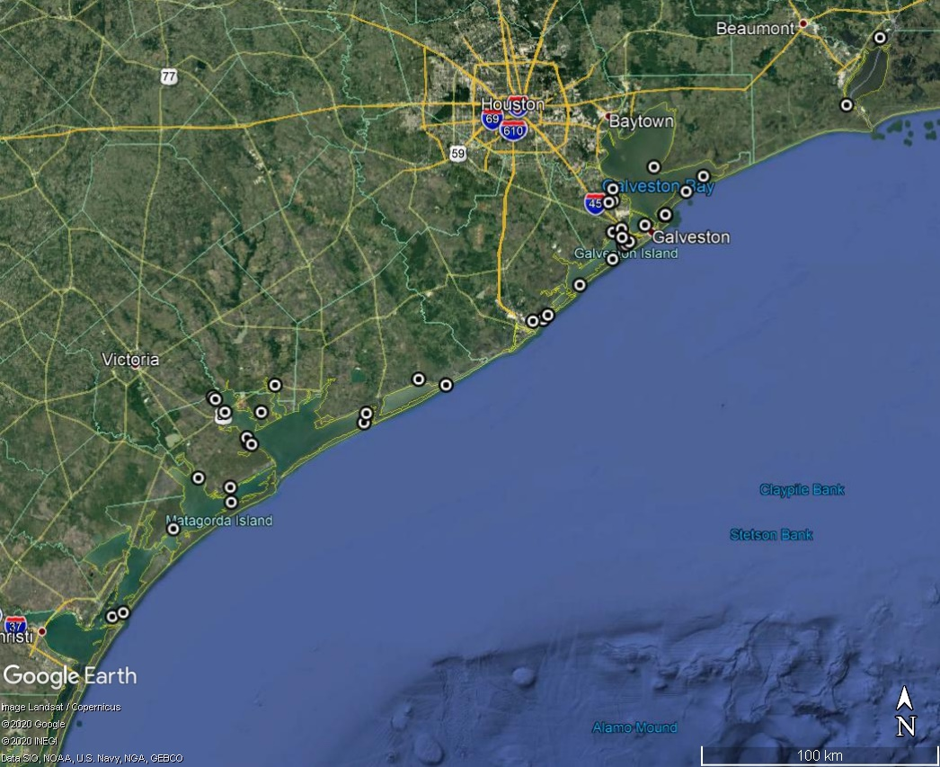
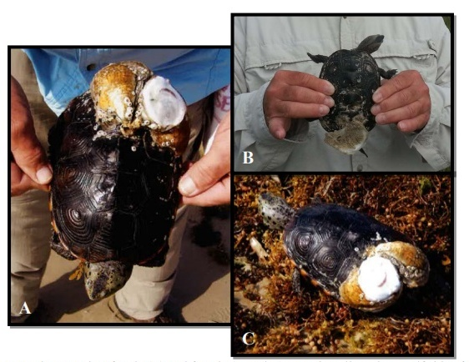
“Have You Seen Me?” Campaign

Slide 16
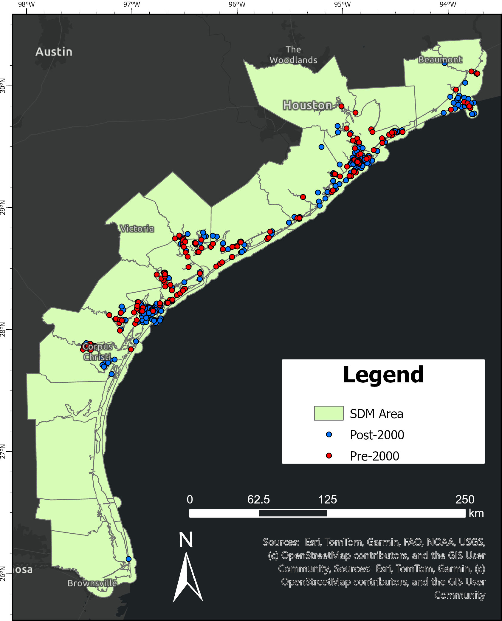
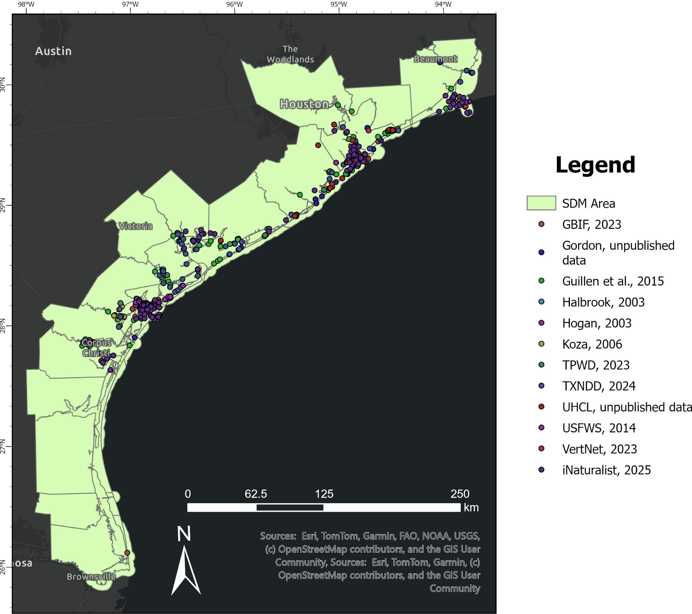

Distribution Modeling
Evaluate historic, current, and future coastal habitat availability utilizing species distribution models.

Slide 17
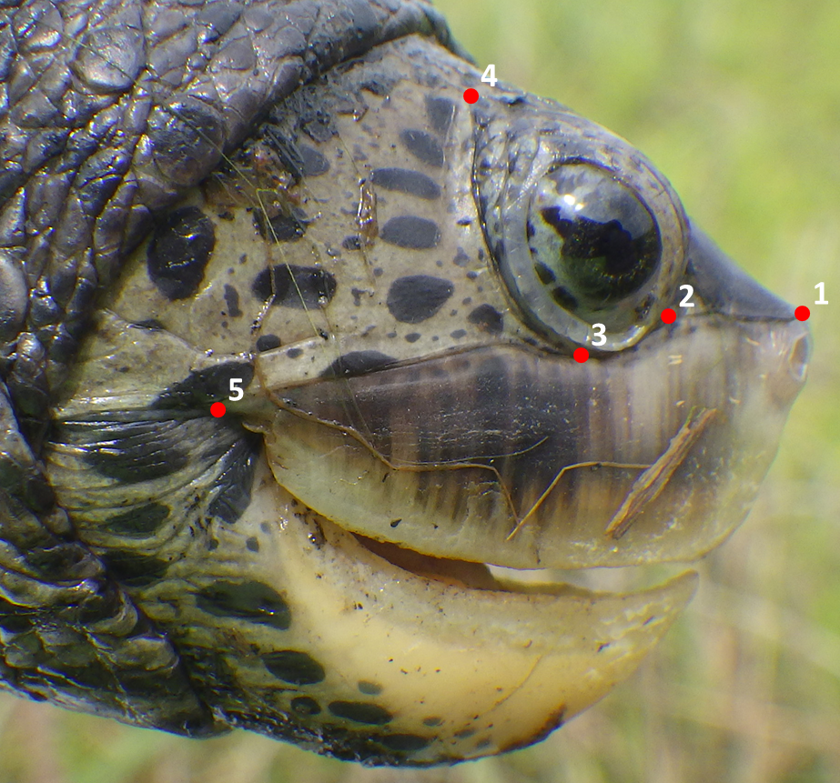
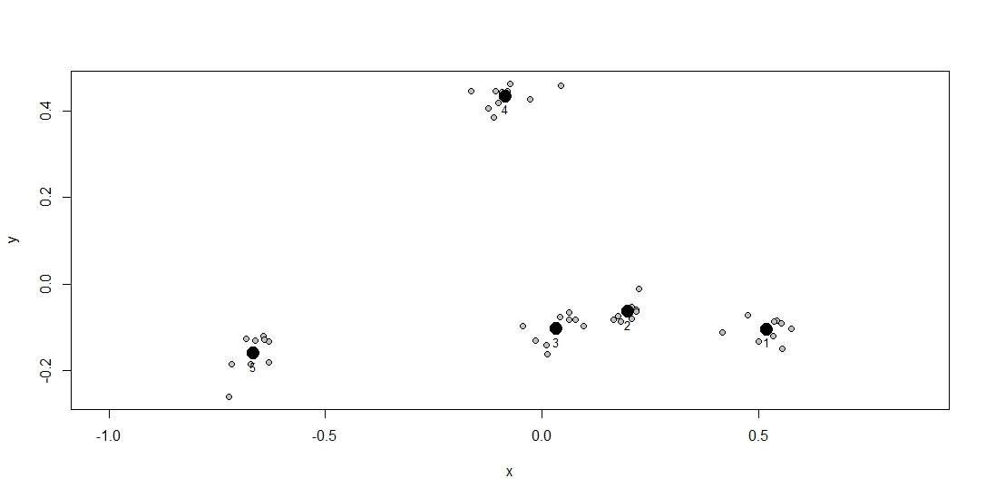
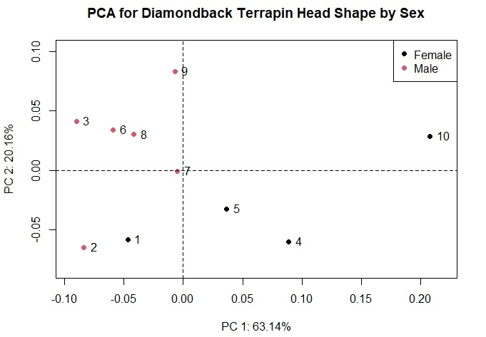
Geometric Morphometrics
Compare morphometric differences and evaluate implications for ecotoxin consumption or exposure.

Slide 18
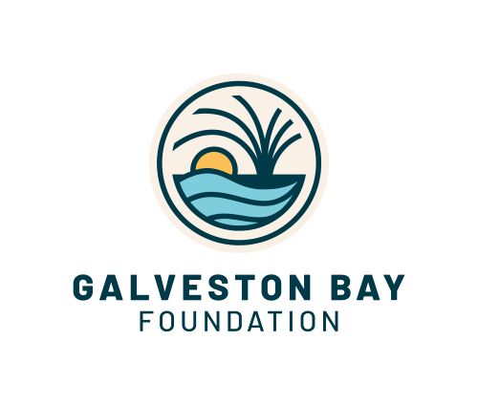
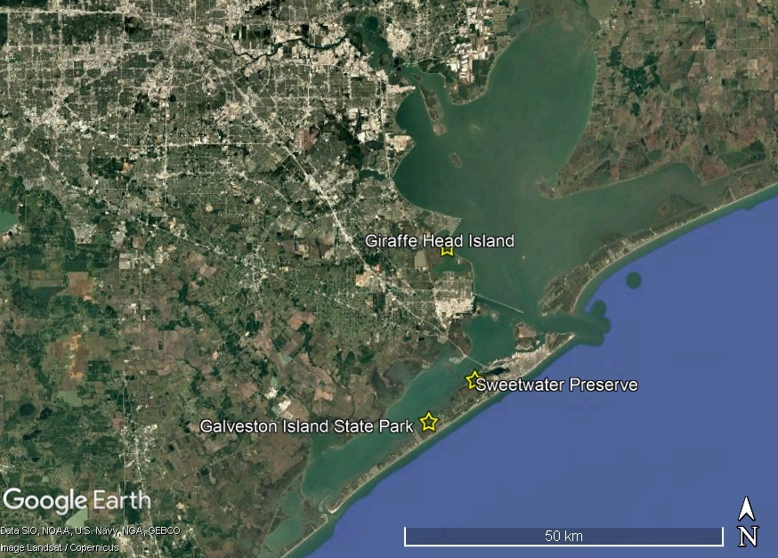






Project Idea – Coastal Restoration and Terrapin Nesting

Slide 19
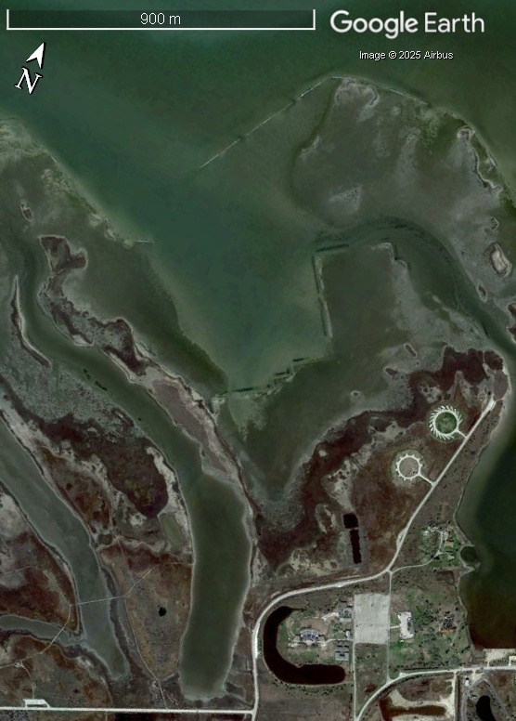
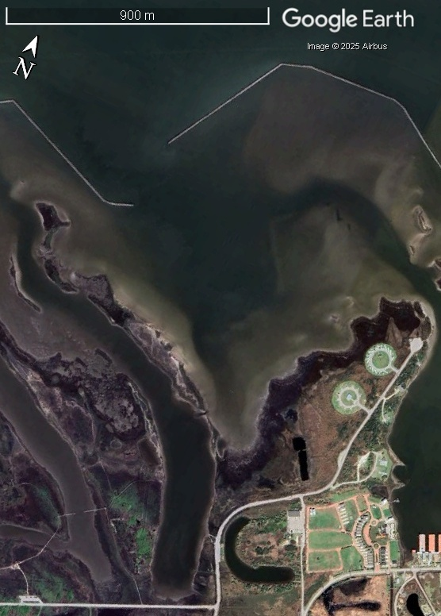
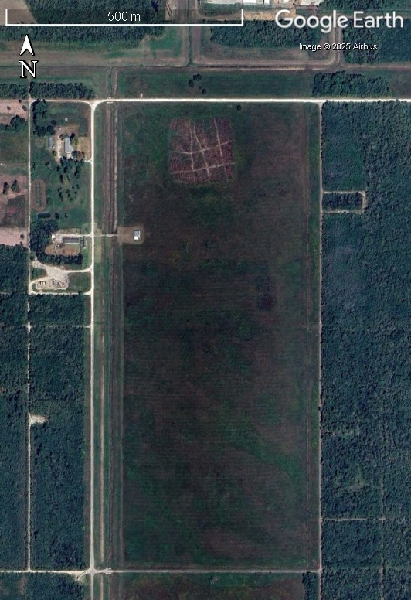
Project Idea – Coastal Restoration and Terrapin Nesting
February 2010
April 2025

Slide 20
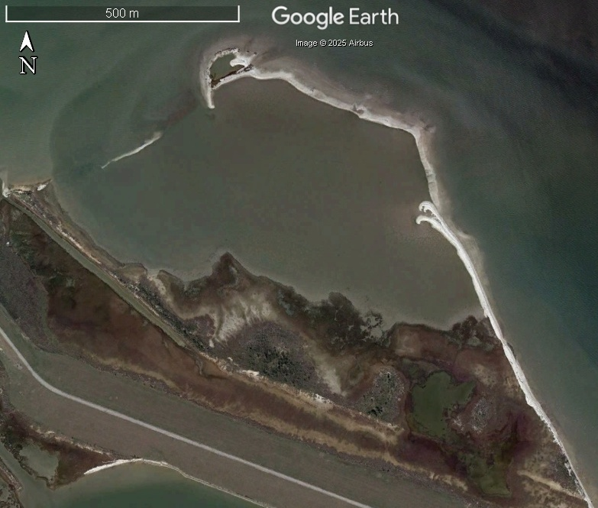
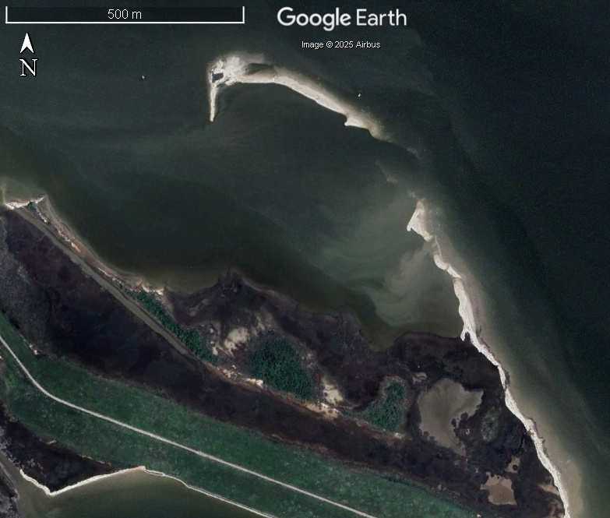
Project Idea – Coastal Restoration and Terrapin Nesting
November 2011
April 2024

Slide 21
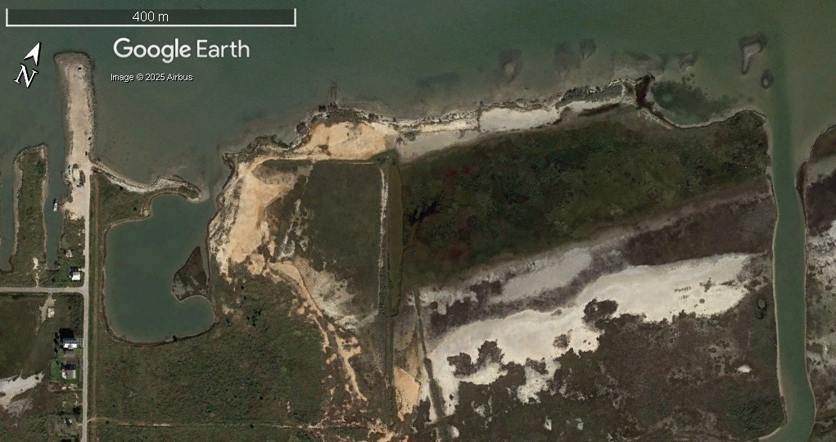
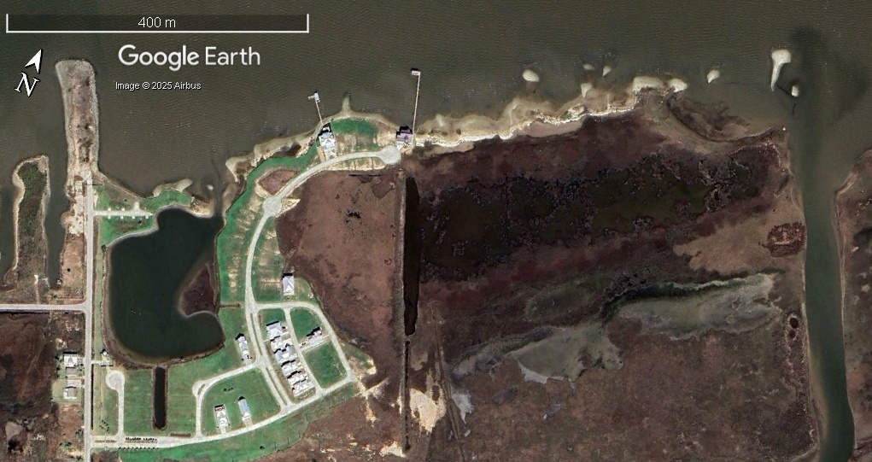
Project Idea – Coastal Restoration and Terrapin Nesting
April 2014
March 2025

Slide 22
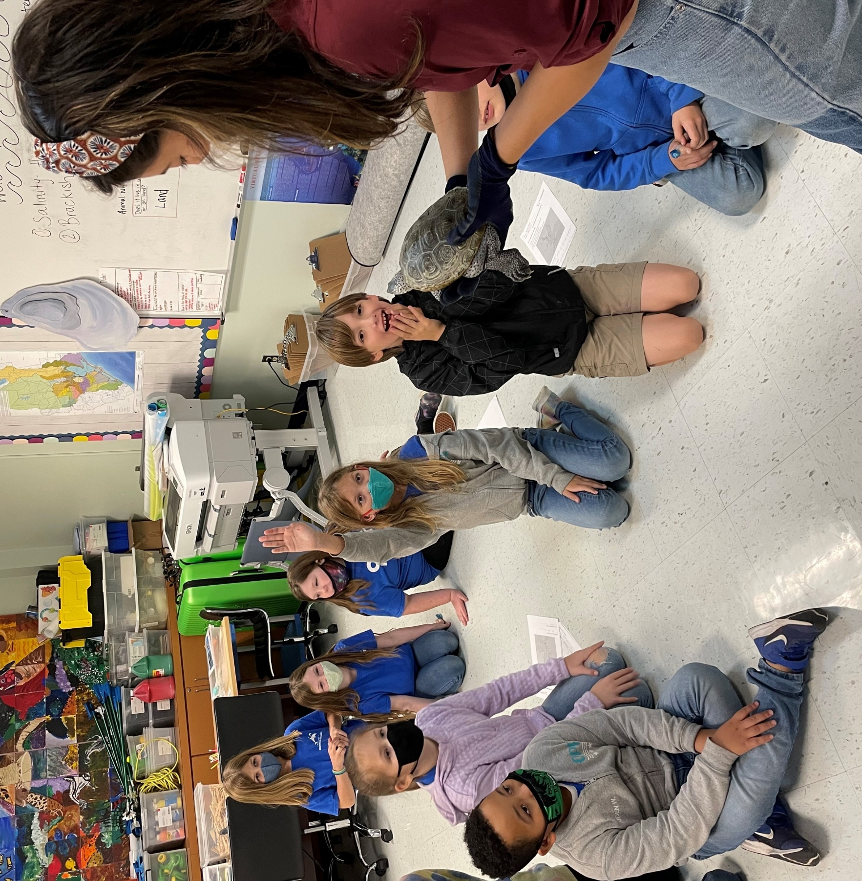
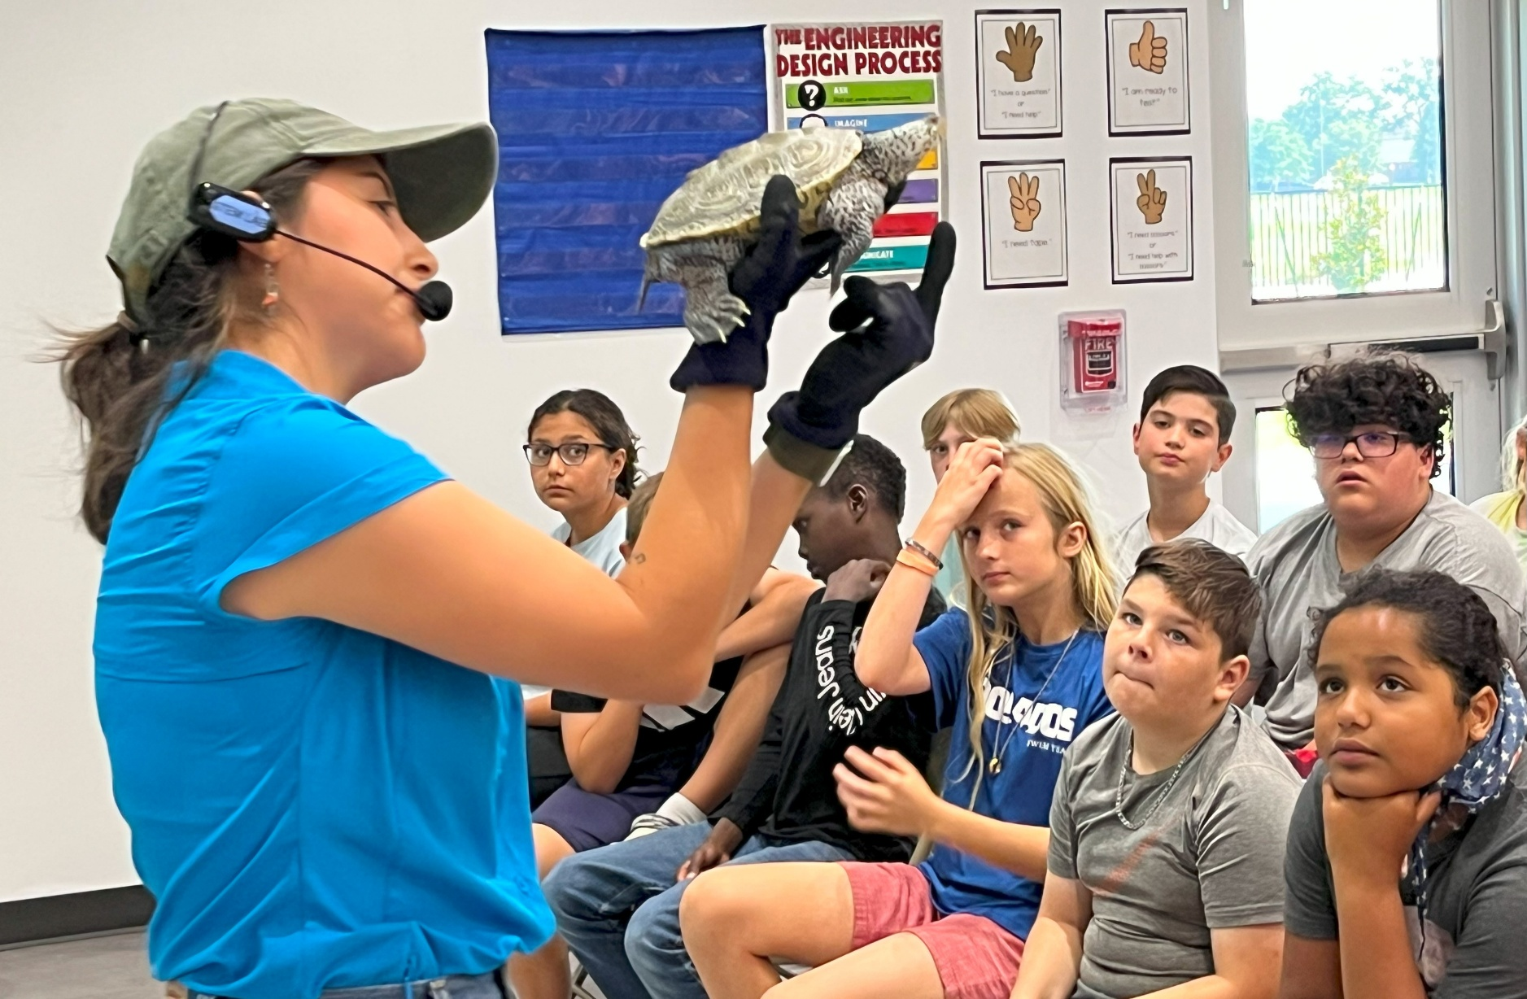
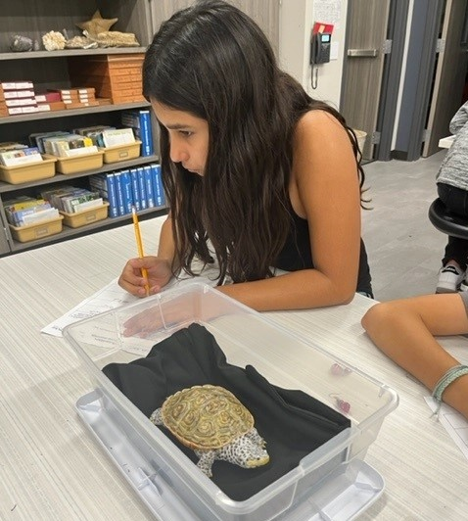
Project Idea – Coastal Restoration and Terrapin Nesting

Slide 23
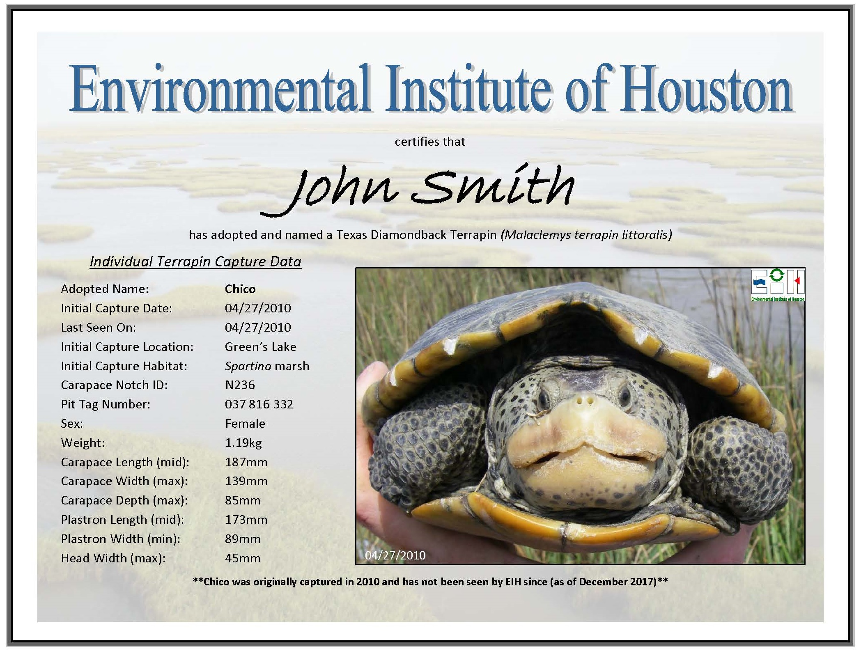
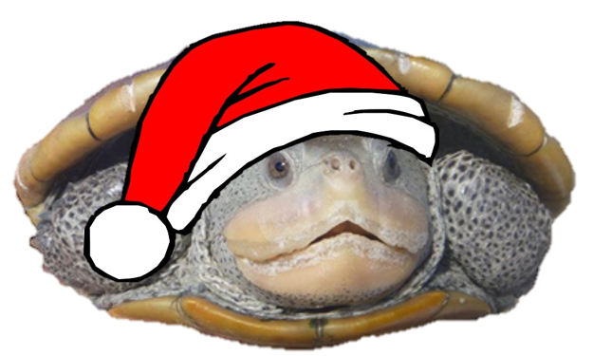
Shameless Plug
Terrapin Adoption Program
Funds our ongoing population monitoring
Funds graduate research opportunities
Allows volunteers to get out in the field with us!
Adopt by Dec. 5th
for delivery by Dec. 25th
https://www.uhcl.edu/environmental-institute/outreach/adopt-terrapin

Slide 24
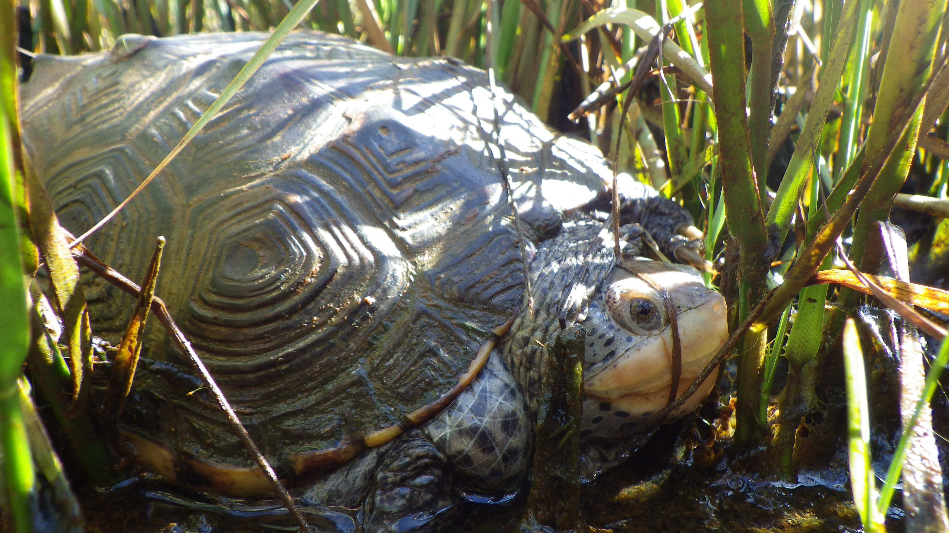
Questions?
Mandi Gordon
Environmental Institute of Houston
University of Houston – Clear Lake
2700 Bay Area Blvd.
Houston, TX, 77058
Gordon@uhcl.edu; 281-283-3794

Slide 25
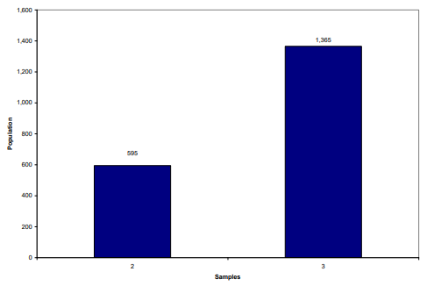
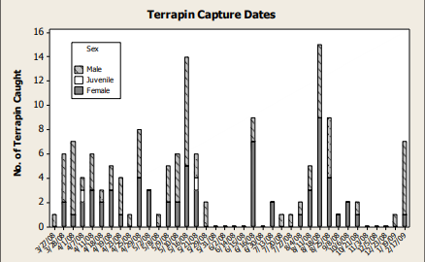


Population Characteristics in West Bay (2008-2010)
Objectives:
  Provide baseline population estimates
  Provide baseline demographic data
Haskett (Ondracek) and Guillen, 2010 (EIH Report No. 10-017)
https://www.uhcl.edu/environmental-institute/research/completed-projects/distribution-demographics-diamondback-terrapin
Notes:
Very first study, funded by Houston Zoo. Essentially one full year worth of field data, not nearly enough for a full population assessment.
We were able to collect some worthwhile baseline data about population size and demographics. Much of what we learned from this study should be attributed to our first graduate student…

Slide 26
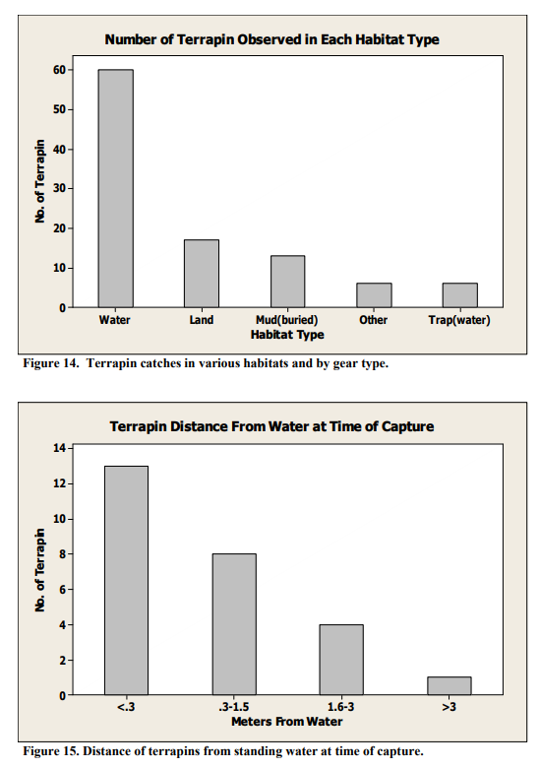
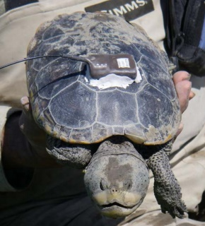
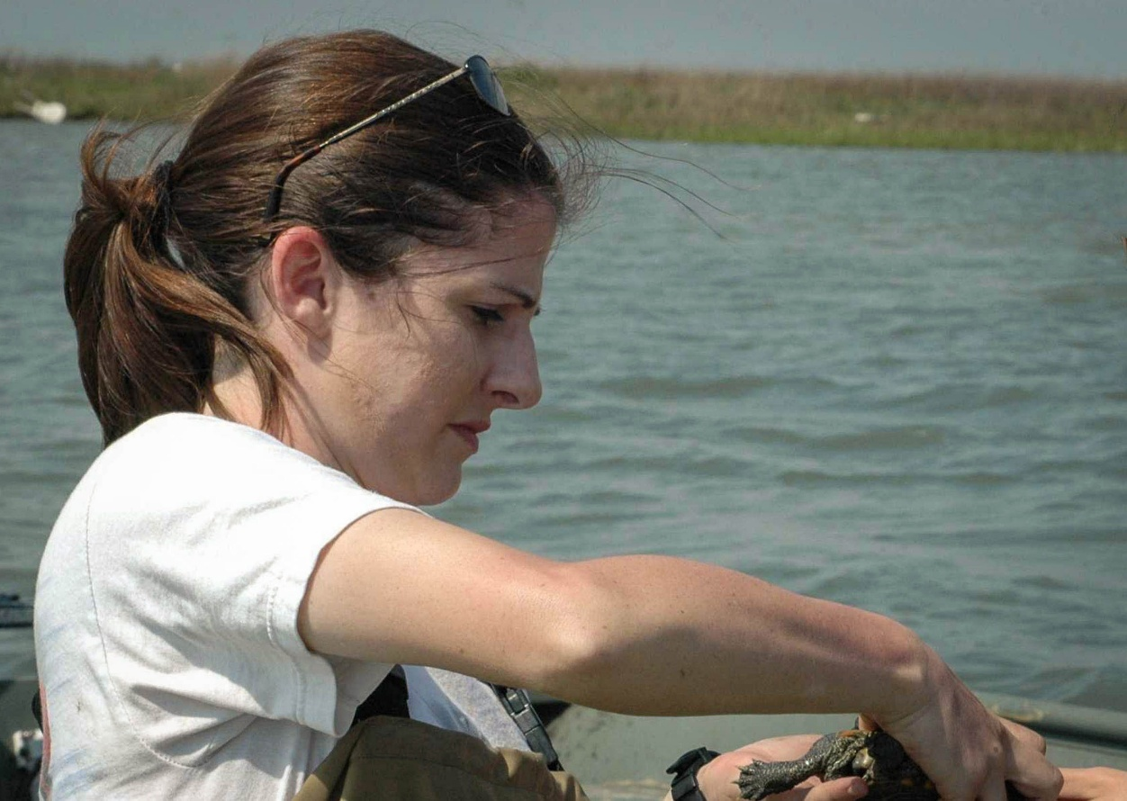
Abundance and Movement in the Deer Island Complex (2009-2010)
Objectives:
  Estimate population densities
  Gather baseline demographic data
  Describe habitat use and movements
  Develop standard protocols
Haskett (Ondracek), 2011 (M.S. Thesis)
https://www.uhcl.edu/environmental-institute/research/completed-projects/distribution-demographics-diamondback-terrapin
Notes:
…Kelli Ondracek. Her thesis overlapped significantly with the Houston Zoo study.
Kelli established our longest monitored population in the Deer Island Complex
She was also the first student to use radiotelemetry to track movements.

Slide 27




Short Term Temporal Trends in Activity and Habitat Selection (2010-2012)
Objectives - Characterize short term trends in:
  Behavior
  Activity
  Habitat Selection
  Daily Movement
Clarkson, 2012 (M.S. Thesis)
https://www.uhcl.edu/environmental-institute/research/completed-projects/terrapin-population-status
Notes:
Emma’s primary goal was to characterize much of the day-to-day affects on terrapin populations in Galveston Bay.
She employed a wide range of capture methods including:
Acoustic telemetry
Radiotelemetry
And even performed night searches in an attempt to determine diel patterns in activity.

Slide 28


Blue Crab Fishery Bycatch Mortality (2012-2014)
Objectives:
  Observe patterns in by-catch mortality between trap types
  Estimate magnitude of by-catch based on historic fishery data
  Provide demographic data
  Estimate habitat use and resource needs
  Develop and refine a habitat suitability index model
Guillen and Oakley, 2013 (EIH Report No. 13-004)
https://www.uhcl.edu/environmental-institute/research/completed-projects/bycatch
Notes:
Joint project between Texas Parks and Wildife and U.S. Fish and Wildlife Service.
Represented the largest effort to date on assessing population structure and impacts of crab fishery to terrapin populations in Galveston Bay.

Slide 29



Nesting Ecology (2012-2014)
Objectives:
  Determine timing of nesting
  Quantify physical attributes of nesting areas
George, 2014 (M.S. Thesis)
https://www.uhcl.edu/environmental-institute/research/publications/documents/george-2014-ms-thesis.pdf

Slide 30



Population Surveys of the Mid- to Upper-Texas Coast (2014-2015)
Objectives:
  Develop initial estimate of distribution in previously un-surveyed bay systems
  Determine critical factors affecting distribution
  Develop density and/or population estimates
  Identify habitat associations
Guillen et al., 2015 (EIH Report No. 15-001)
https://www.uhcl.edu/environmental-institute/research/current-projects/terrapin-life-history

Slide 31








Want to Learn More? https://www.uhcl.edu/environmental-institute/research/publications/
2015
2016
2017
2021

